Slide 1
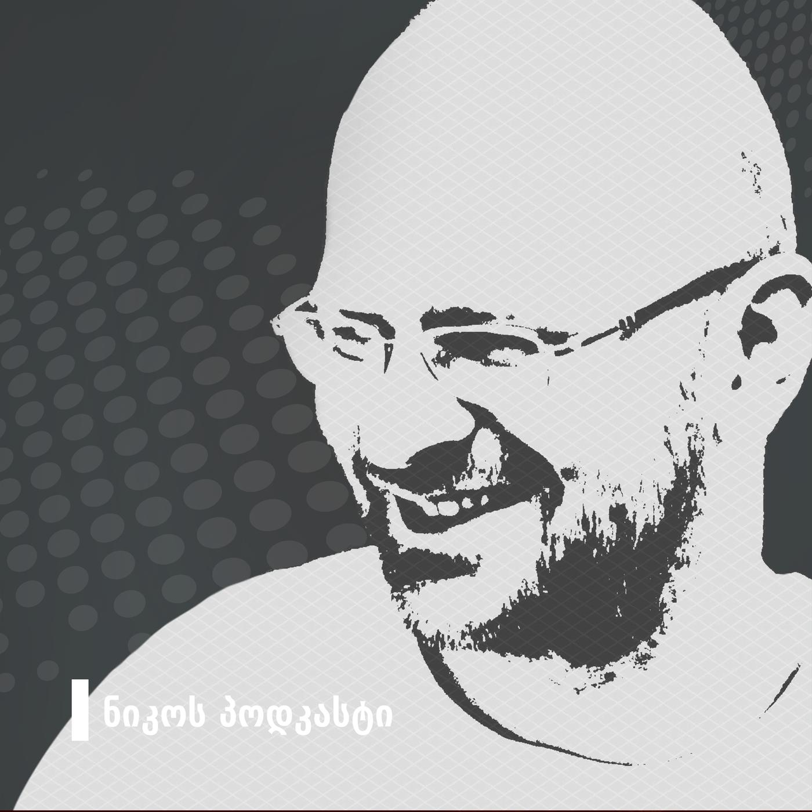

FROM RADIO TO
PODCASTING

Slide 2
Niko’s Podcast
Started in 2015
Started as a radio show
Probably the most popular podcast ever

Slide 3
Asatiani’s Corner
Started in 2018
Started as a podcast
Almost as good as my show

Slide 4
What’s the difference?
Differences subtle but important. There is no “one weird trick” to turn a radio show into a podcast. The main difference is how the audience listens to you and what they expect from you.

Slide 5
Community Building:
NIKO VS SALOME
I have a page (12K followers)
She has a group (8,5K members)

Slide 6

But what are these about?

Slide 7
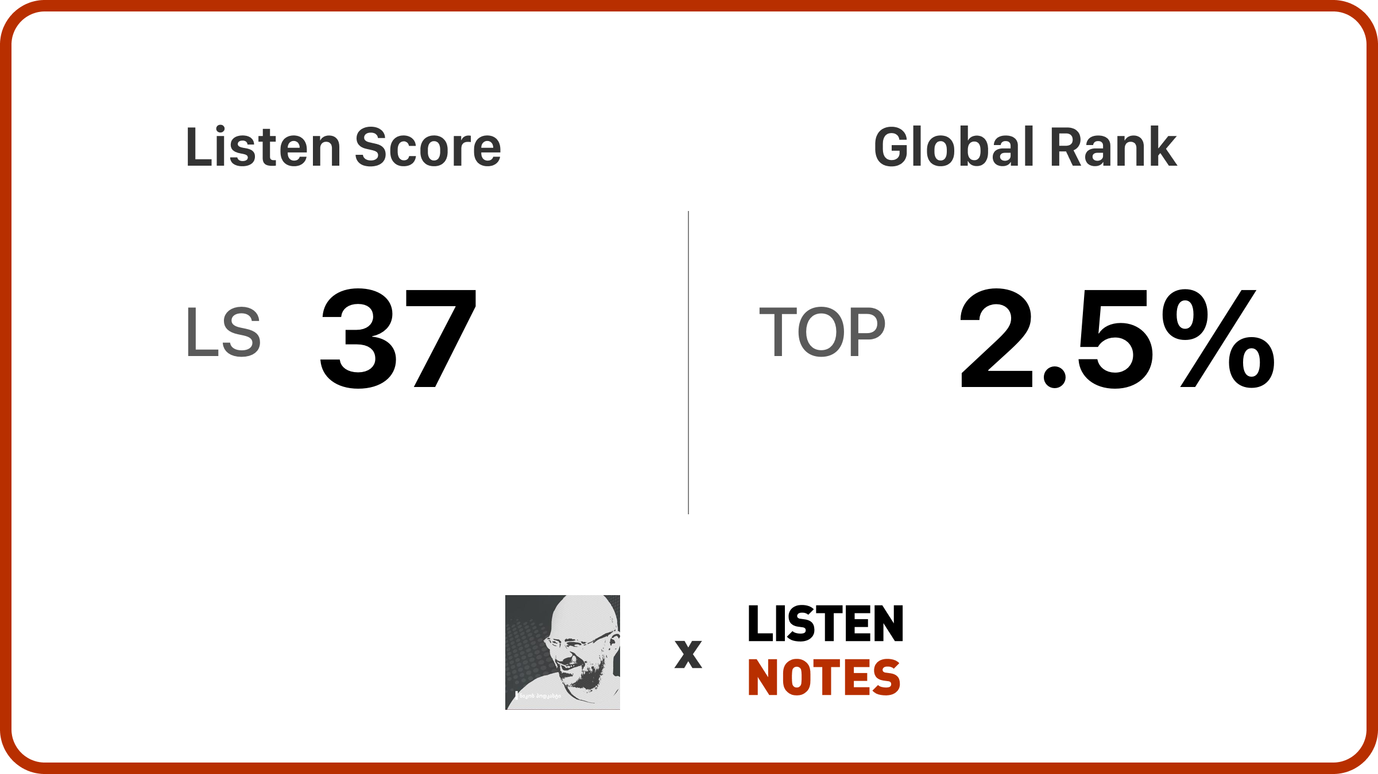
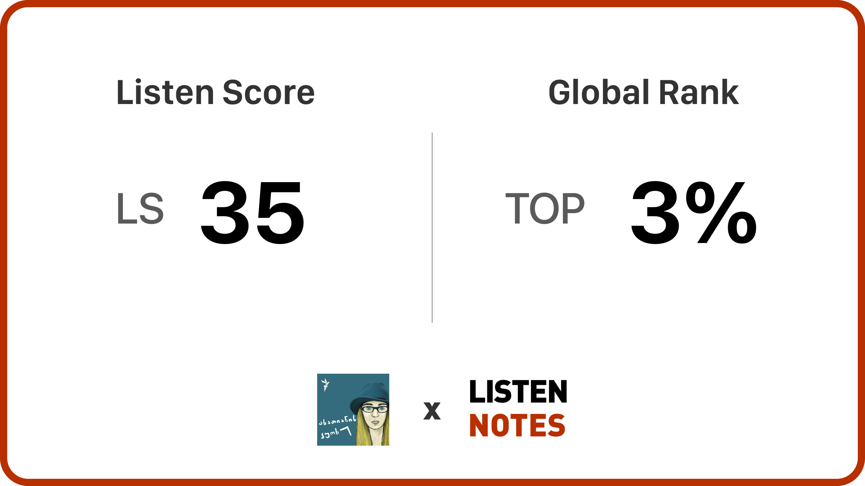
Does anyone listen?

Slide 8
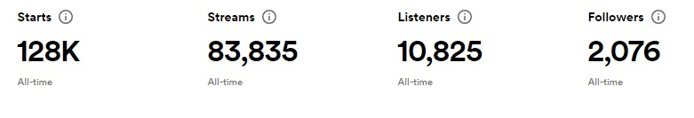
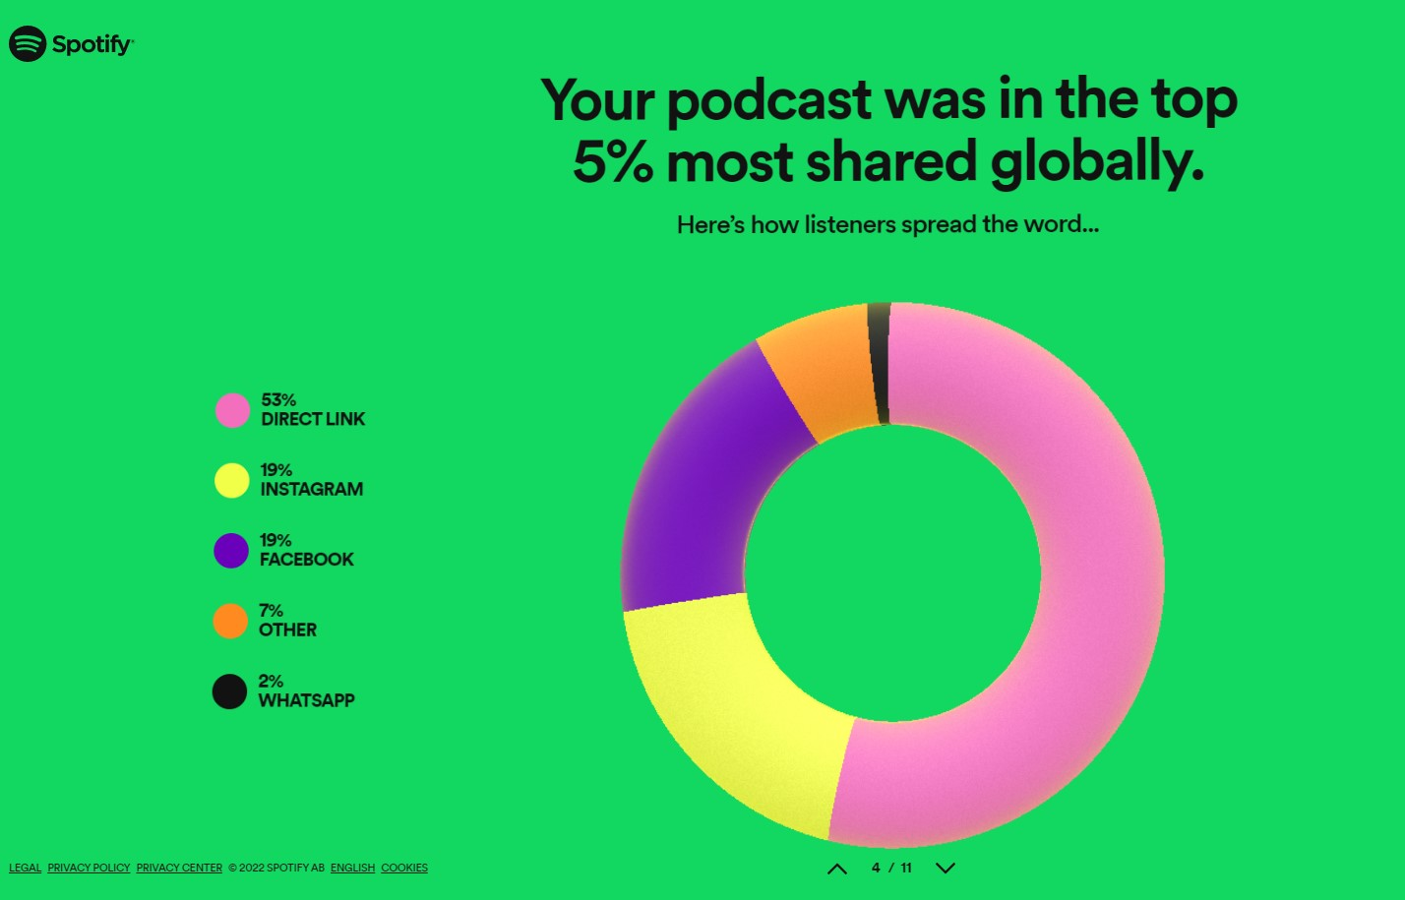
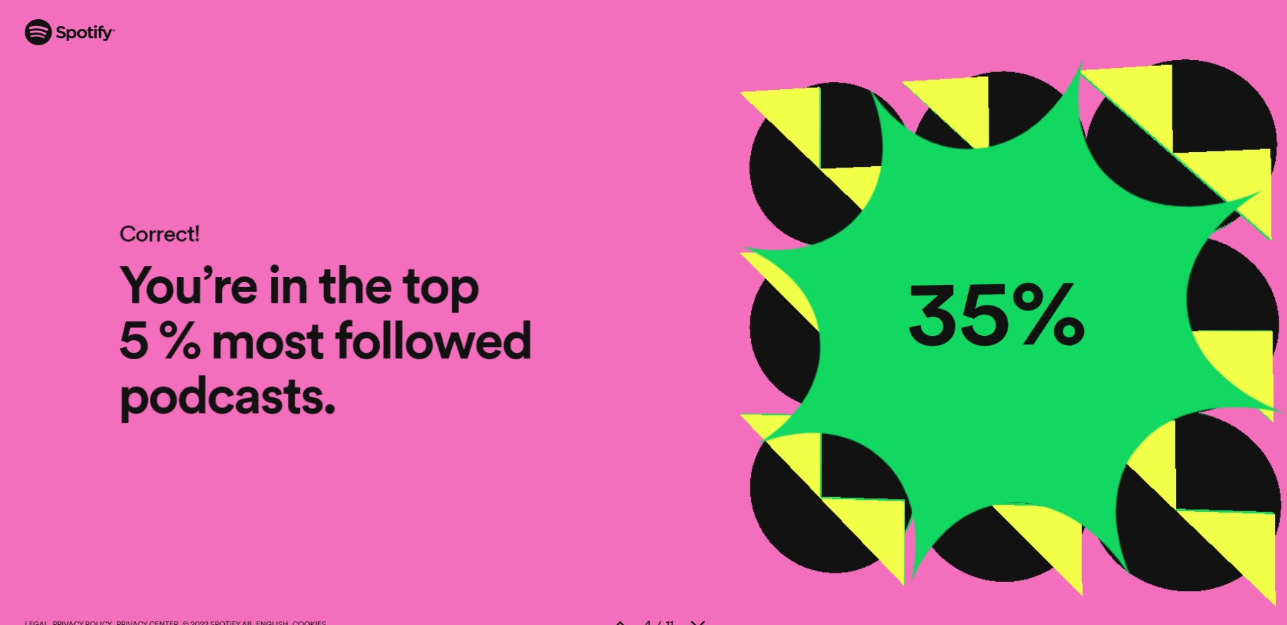
Does anyone listen?

Slide 9
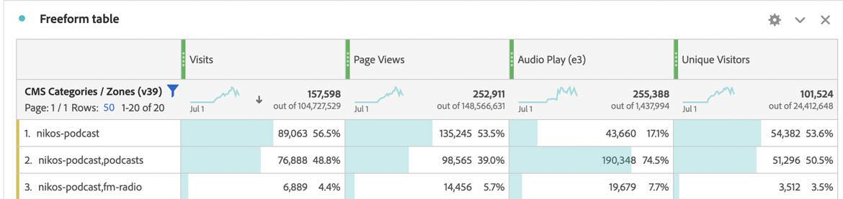
Does anyone listen?

Slide 10
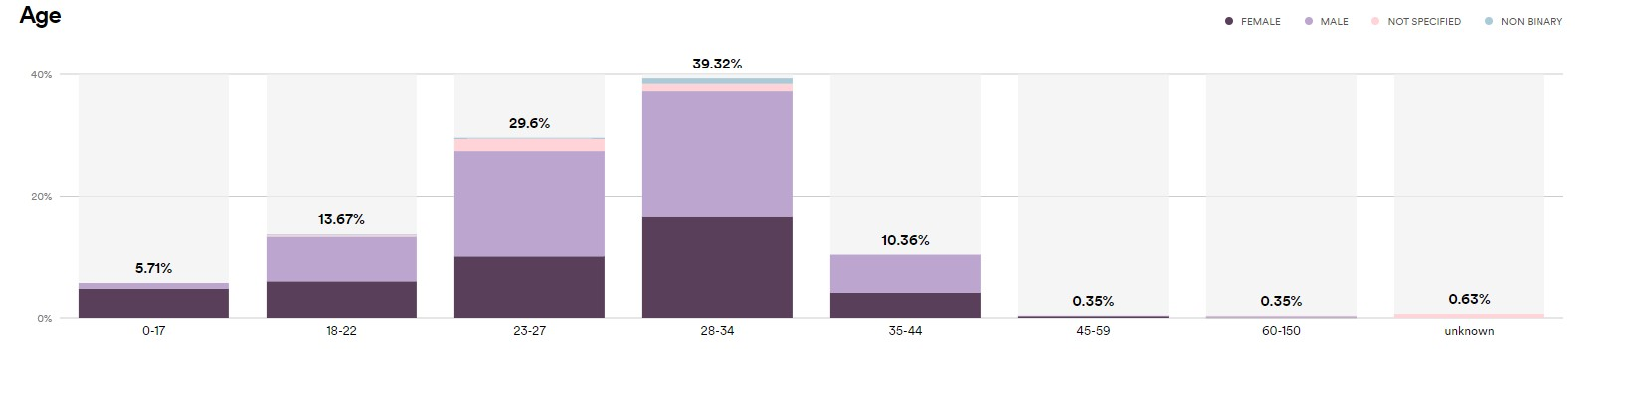
Who are these people?

Slide 11
What’s the point?
For the Radio
For the host

