Slide 1
RFE/RL’s Podcast and Newsletter Playbooks

Slide 2


How many of you…

Slide 3
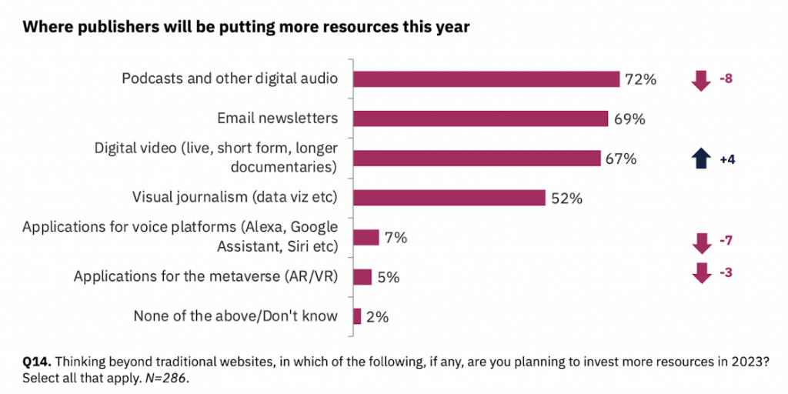

Slide 4


Slide 5
“Ideas are easy; execution is everything”
John Doerr, “Measure what matters”

Slide 6
How these playbooks can help you
Audience: Who is your audience? What are their needs, problems and dreams?
Challenge yourself: Is your idea serving your audience (or is it a vanity idea?)
Value proposition: Who are you? What feeling/s you want people to associate with you?
Mission: what is your product trying to accomplish for your Service/Team
Competitors: What sets you apart from your competitors? What are the gaps and opportunities in the market?

Slide 7
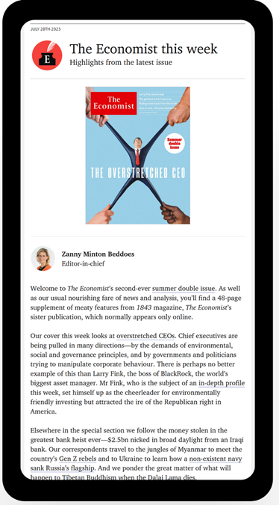
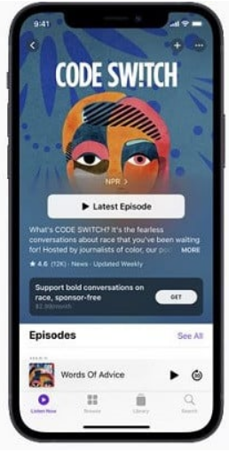
Understanding specificities
Audience is proactive and makes a conscious choice (Subscribe here)
Common challenge: discoverability
Consistency and commitment: building an audience takes time
Excellent products for building trust and loyalty
Difficult to block by censors

Slide 8
Product process
Value proposition
Launch
3
You did it! This is just the beginning of an amazing journey!
8
What is exciting and different about your project?
Measure success
iterate
2
6
Define KPIs to measure what success looks like
Make you idea evolved using data to validate your initial value proposition.
1
audience
Research the needs, expectations, problems and dreams of your target audience
7
4
prototype
Review
Plan
Prepare pilots and drafts, gather feedback and incorporate changes.
Review your KPIs and value proposition
Production, distribution and contingency situations.
5

Slide 9
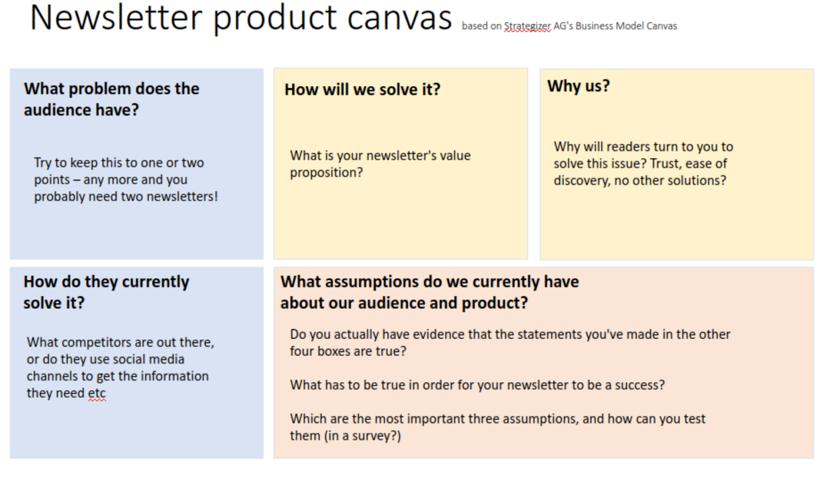

Slide 10
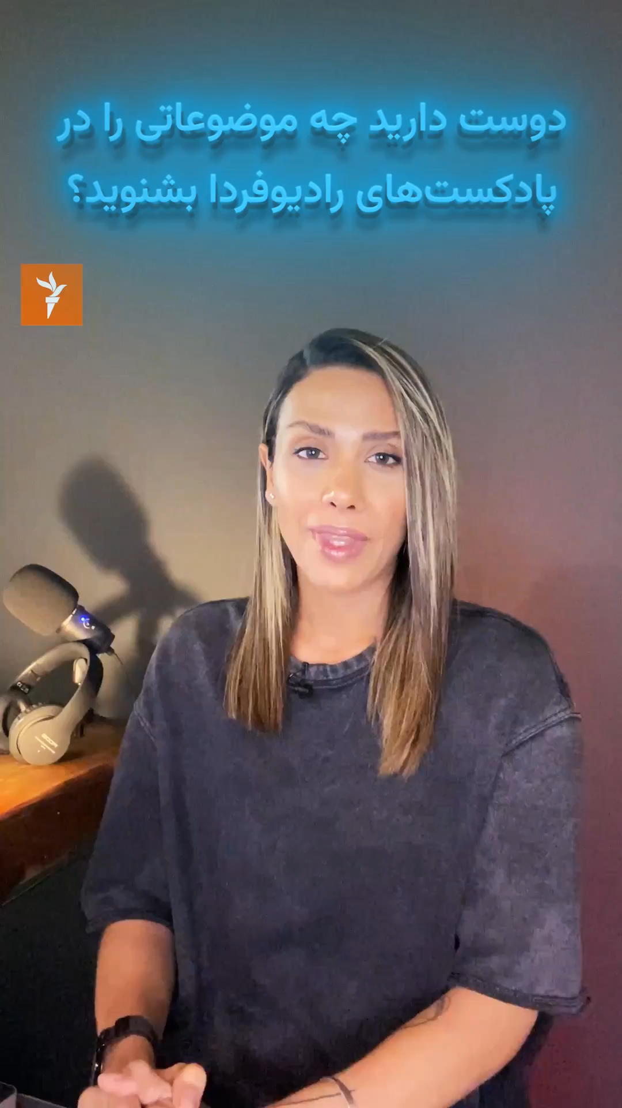
The Podcast playbook, first edition
Product thinking tactics
Audio and video trailer new projects
Promotion before launching to encourage subscription
RSS improvements: sound quality and number of episodes

Slide 11

The Podcast Playbook, second edition
How to record outside the studio
How to publish your podcast on YouTube
Account governance: corporate emails on RSS and individual Apple podcast channels
CMS changes: serial and episodic

Slide 12












New shows!

Slide 13


Feedback is a gift!

Slide 14
“If you don’t know where you are going, you might not get there”
Yogi Berra, American baseball catcher

Slide 15
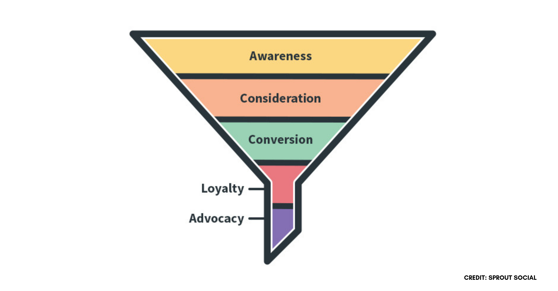
Building relationships and trust

Slide 16
How to measure success
Define metrics based on your goals, not the other way round
Newsletters
Podcast
Average time played (Engagement)
≥ 40% of the episode
Plays per episode in a 30-day period (Impact)
1,000 = considered the minimum average for monetization
Subscribers/followers (Loyalty)
Total number should grow consistently
Subscribers
Open rate
Click rate
Engagement by segment
e.g. # of subscribers who open 50% of mails
Sign-ups as a % of web traffic
Feedback and surveys

Slide 17
What we are doing
Developing effective cross-promotion strategies
Podcast
Apple podcast channels for all Services
Account governance and access to metrics
Experimenting with Spotify engagement tools
RSS tracking system for better metrics and see the big picture
Newsletters
Enhancing welcome emails
Rethinking sign-up boxes and registration pages
Knowing our subscribers better: On-boarding, off-boarding and post-launch surveys
Introduce A/B testing and other techniques

Slide 18
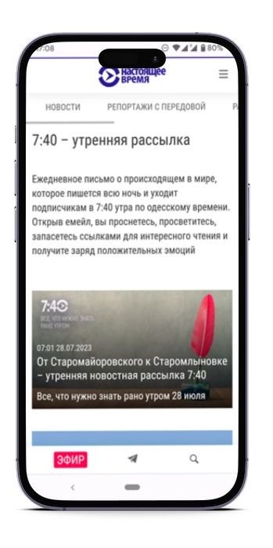
Resources
The Podcast Playbook (second edition)
The Podcast Process
Podcast brainstorming questionnaire
The Newsletter Playbook
Newsletter brainstorming templates

Slide 19

The start of a journey
Ongoing process: Review, iterate and evolve
Office hours: every Wednesday 11-13
Let's continue the conversation on Teams:
Podcast channel
Newsletter channel
Contact Carla Pedret, email or teams

Slide 20

Questions?

