Slide 1

Unlocking YouTube Insights with Emplifi Dashboards
Tbilisi Digital Summit

Slide 2
The Struggles with metrics:
Metrics are too general, not specific enough (don’t tell you economic background of person)
Quantity and quality? – Good at tracking reach but not good at tracking impact
Which KPI? Unclear which one, and who decides – on which level, Service? Bureau? Organization?
How to interpret? What and Why?
Censorship in closed countries, do we have real metrics?
Reach vs Impact
Understanding who the actual audience is, and who is the target audience
Metrics are limited.

Slide 3
1. Emplifi 101
2. Youtube dashboards & Competitors
3. Emplifi in practice
4. Your turn: Implementation + conversation

Slide 4







Emplifi
Analytics are available on each native platform, but these analytics are limited. By connecting each platform’s insights API, we’re able to look at them in Emplifi through 3 main features: dashboards, analytics & content hub.

Slide 5
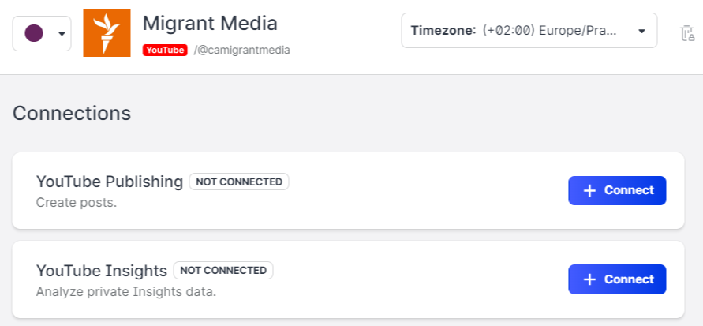
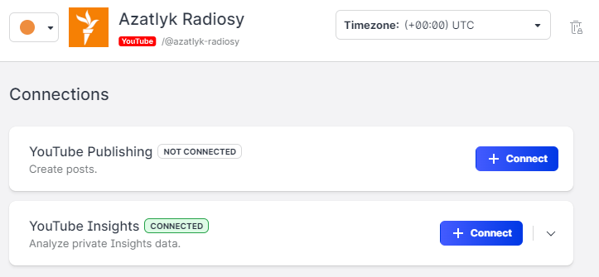




Insights? Connected.
The first step is to connect your page’s insights to Emplifi.
✖️
Platforms we’re able to connect:
Platforms we’re able to connect:
✔️

Slide 6
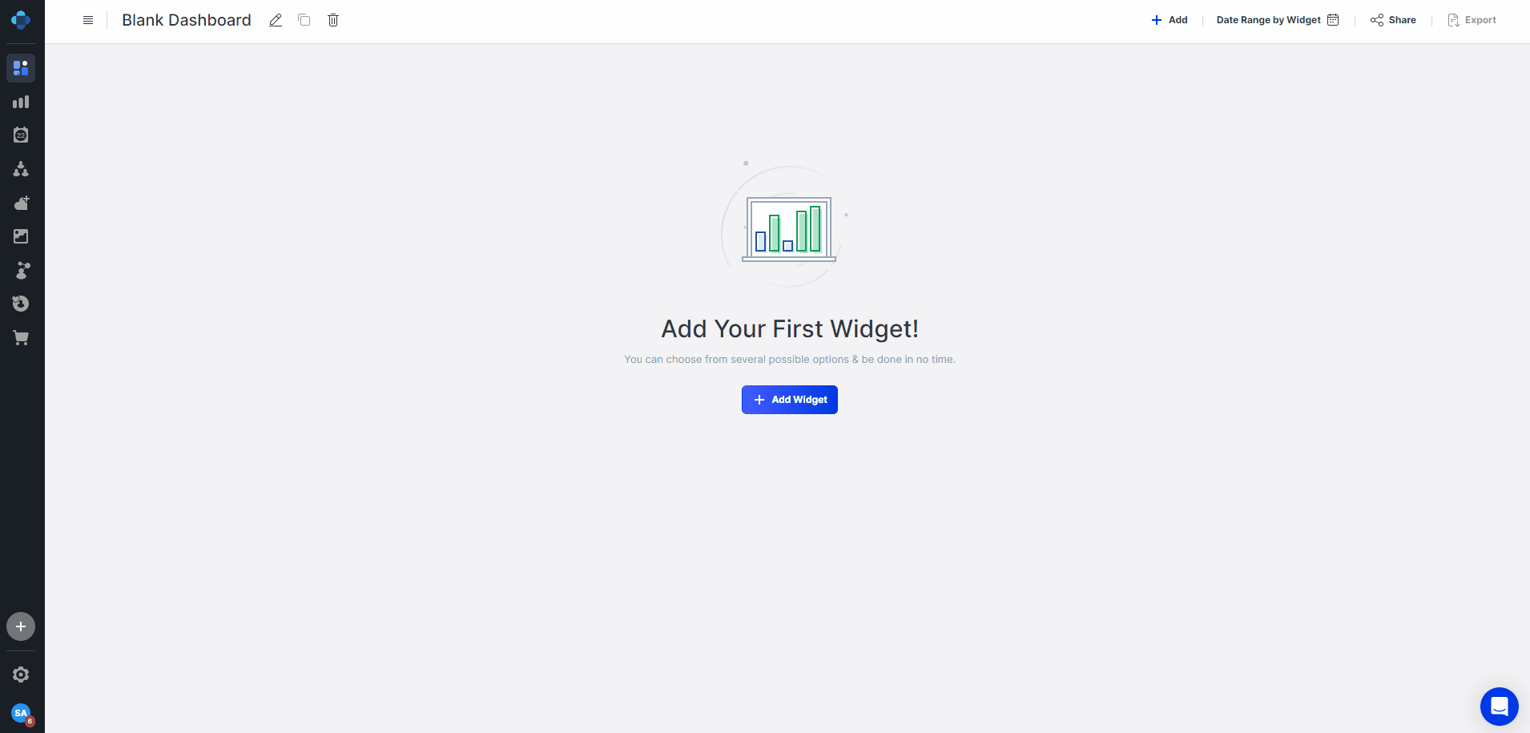
Dashboards Available?
Emplifi has a variety of ready-made FB, IG, TikTok and YT templates for you to use.

Slide 7



Youtube vs emplifi
YOUTUBE
EMPLIFI
Insights at the profile level*
Content type segregation
Real-time metrics
Expanded content metrics
racks competitor engagement metrics
Compares your content to competitors
Simplifies KPI metrics tracking at the profile level* and post level**
*Profile level means that the insights are on the whole profile (channel) and the views received during the selected date range, regardless of when the videos were published. Post level means that the insights are on the views received within the selected date range for just the videos published within that same time frame.

Slide 8
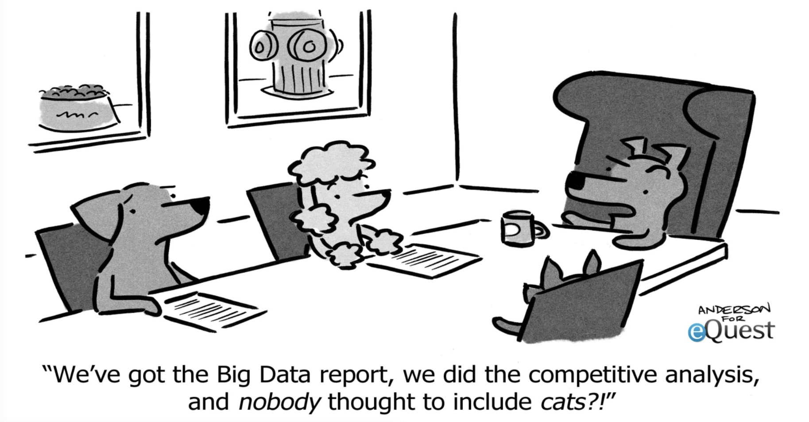
Why are competitors important?

Slide 9
How Can it help you?
Benchmarking & Performance Evaluation
Strategy Enhancement
Audience Insights & Customization
Market Trends & Differentiation
Continuous improvement

Slide 10
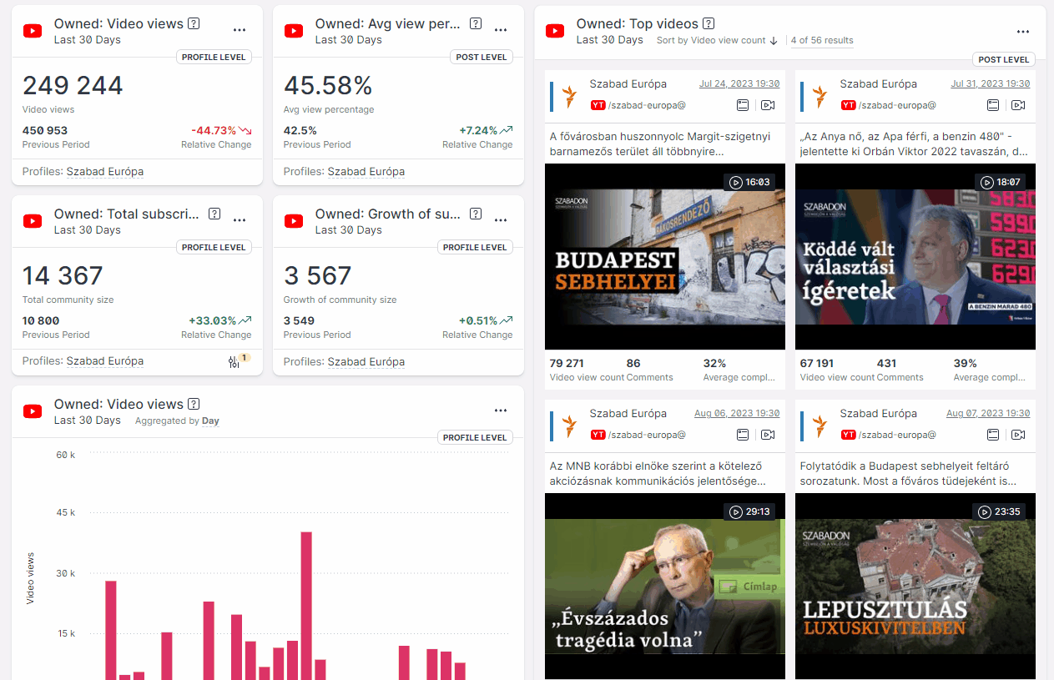

Szabad Európa: YouTube Dashboard
How to Access and Navigate the Emplifi Dashboard for Your Service's YouTube Channel:
https://scribehow.com/shared/How_to_Access_and_Navigate_your_Services_YouTube_channels_dashboard__3rflt52-TXSJWUyPkSYMcg

Slide 11
Rollout TIMELINE
YouTube
Tiktok
Facebook
Instagram
All Services will receive a YouTube Dashboard by the end of 2023.
TikTok Dashboards will be next.
META platforms will be rolled out once we are done with TikTok.
Facebook and Instagram will be tackled alongside each other.

Slide 12
Who should have access to emplifi?
Service Directors
Digital Leads
Social Media editors
Anyone who produces content for digital platforms!

Slide 13
How do I get access to Emplifi?
Reach out to us!
Audience & Growth:
  Sandra Abdulhakova abdulhakovas@rferl.org
  Martin Vejvoda vejvodam@rferl.org
We will send you an invitation to create an account on Emplifi!

Slide 14

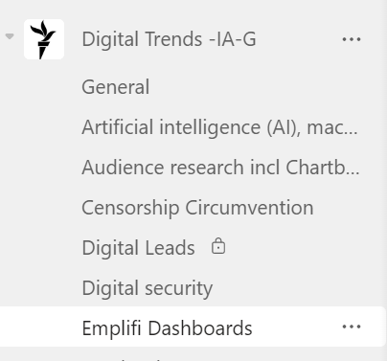
more questions?
Ask a question on our Teams Emplifi Channel…
Or reach out personally ☺

Slide 15
THANK YOU!
Questions?
+
Exercise

