Slide 1

Private Engagement on Instagram via Emplifi
Lightning Chat #114
Sandra Abdulhakova

Slide 2
Private Engagement on Instagram
Engagement is a great indicator of performance for your content on social media. Measuring how your audience interacts with your posts can give you valuable insights into their preferences and interests. But what if it’s not safe for your audience to engage with your content? This is when private engagement comes into play.
We will explore the dynamics of public engagement versus private engagement on Instagram and how you can track it in Emplifi.

Slide 3

Instagram performance via emplifi
Measuring which interactions are going to which posts (Videos, Reels, Carousels/Albums, and Photos) can tell you a lot about what content the audience is receptive to, and what content they find useful.
Notes:
Most often, when it comes to performance, or specifically engagement, we, in the Audience & Growth team measure how many times our Services’ audience interacted with the posts published by the Services to their Instagram feeds. And we do this via Emplifi, our third-party analytics tool for social media. And this can be helpful because it allows us to see which content the audience is receptive to and what content they find useful! And we do this mainly by tracking likes and comments on Instagram.

Slide 4



Likes + Comments
Radio Tavisupleba’s most-liked post last month.
“⭕ Salome Zurabishvili met Emmanuel Macron in Paris”
Current Time’s most-commented-upon post last month.
“Residents of Nagorno-Karabakh leave their homes and go to Armenia”
Notes:
For example, we see that in September, the post about the Georgian president meeting the French president in Paris was quite important to Radio Tavisupleba’s audience. And Current Time’s coverage of residents of Nagorno-Karabakh leaving their homes and going to Armenia following the events of the 19th of September was also quite important as it generated a lot of conversation in the form of comments. But we also know that likes and comments are not the only way you can interact with posts on Instagram!

Slide 5

Your IG Feed looks like this:
Notes:
Because Instagram posts look like this on your audience’s feed. And you can see that you can like a post, you can comment on a post, you can share a post and you can also save a post! And all of these interactions are very important.

Slide 6
Four interactions,
one major difference
PUBLIC ENGAGEMENT
LIKE
COMMENT
SHARE
SAVE
PRIVATE ENGAGEMENT
Notes:
But with these four interactions, there is one major difference. Likes and comments are public interactions and shares and saves are private engagement. What does that mean?

Slide 7

Engagement IS: public & PRIVATE.
LIKE
COMMENT
SHARE
SAVE
Private!
Unlike Likes and Comments which are visible to anyone on Instagram, it is not possible to see who shared your post in their private message and it is not possible to see who saved your posts.
This is only visible to the USER himself or herself.
👀
🤫
Notes:
It means that anyone on Instagram can see who liked a post and who commented on a post, BUT no one can see who shared a post via direct messages or who saved a post. Only the user him or herself can see it on their own personal device.

Slide 8
PRIVATE engagement, when can it be especially important?
all types of engagement are important for any social media presence, but when can private engagement be especially important?
From our experience, it can be very useful to especially track it when it comes to restricted markets.

Slide 9

PRIVATE engagement, when can it be especially important?
Radio Svaboda was labelled an extremist entity. Interacting with its content and even following the page was criminalized.
Despite a decline in likes and comments, saves consistently did better.
And this could be due to the nature of these interactions being more private, so it is something to consider keeping track of, depending on the mediascape in your corresponding market.

Slide 10
HOW can we track all of these interactions on emplifi?

Slide 11




insights on emplifi
Emplifi
The first step is to make sure your page is connected to Emplifi, so we can have access to its analytics and insights.
Analytics are available on each native platform, but these analytics are limited. By connecting your Instagram’s insights API, we’re able to look at them in Emplifi through 3 main features: dashboards, analytics & content hub.

Slide 12
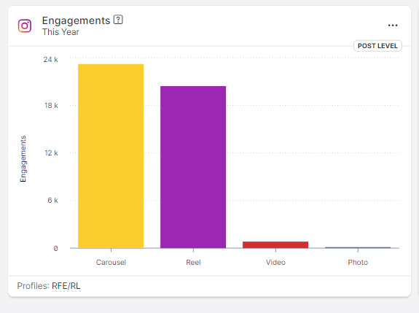
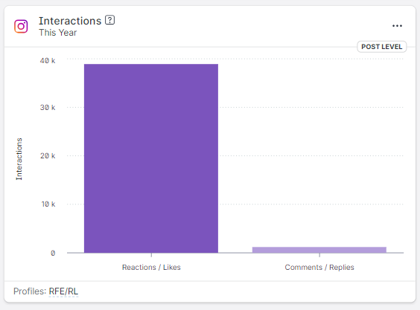
Emplifi offers:
Engagement
Interactions
Includes likes, comments, saves, and only shares for REELS
Cannot breakdown for engagement type
Includes likes and comments
Does not include shares (for REELS) or saves (for ALL posts)
Notes:
Using Dashboards, we are able to track engagement and interactions. And engagement on Emplifi is defined as all the likes, all the comments, and all the saves received by your posts, and only the SHARES received by your reels. Unfortunately, we cannot identify the type of engagement you are receiving, though. Alternatively, we can also look at the interactions received by all of your posts, but this only includes likes and comments when it comes to the type of interactions. So it is pretty limited.

Slide 13
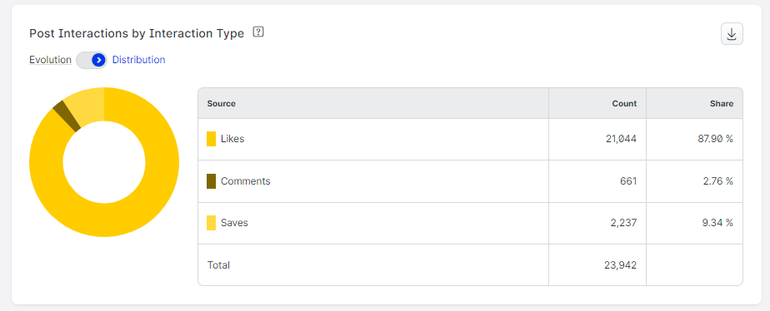
Emplifi offers:
Interactions
Includes likes, comments and saves
Does any include interactions for REELS at all
Notes:
Another option is the analytics tab, this way we can track engagement or interactions types but even that is limited. As it does not account for any interactions received by Reels.

Slide 14
TRAcks ALL insights, all types of engagement for all posts
*(shares are tracked only for reels)
Notes:
That’s why we mostly rely on the content hub, because we have all the insights for all types of engagement for all posts. Unfortunately, as a rule, we only have access to the shares received by reels, but of course, you can track shares for other posts in the analytics available to you on the native apps. So how do we do this, and how can you do it too?

Slide 15
How to use the content hub:
Step 1: you need an emplifi account
You can contact me (Sandra Abdulhakova // abdulhakovas@rferl.org)
And I will send you an invite to the platform!
Who should have access to Emplifi?
Service Directors, digital leads, social media editors, and anyone who produces content for digital platforms!
Notes:
First and foremost, you will need an Emplifi account. If you don’t already, reach out to me and our team will send you an invite to the platform. Anyone can have access to it, and anyone who produces content for social media platforms especially should have access to it as it is our main analytics tool!

Slide 16
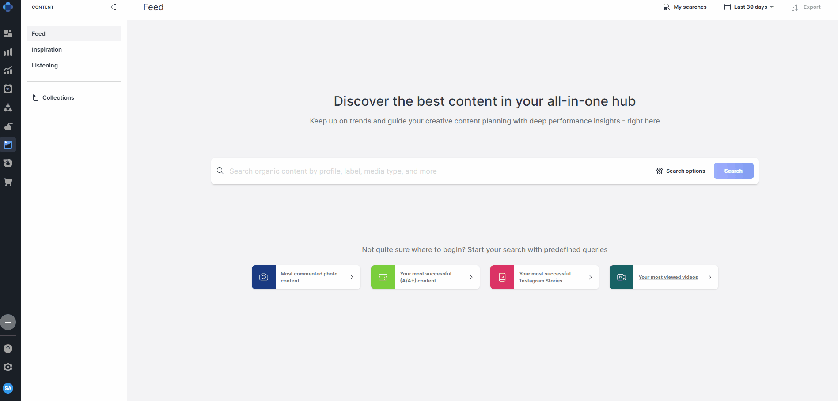
How to use the content hub:
Step 2a:
Navigate to the content hub.
Type in your page’s username, select the date range you want to view and hit search.
You can choose whichever metric you want to view the posts by; date, likes, comments, saves…
This will show you the best-performing posts in each metric

Slide 17
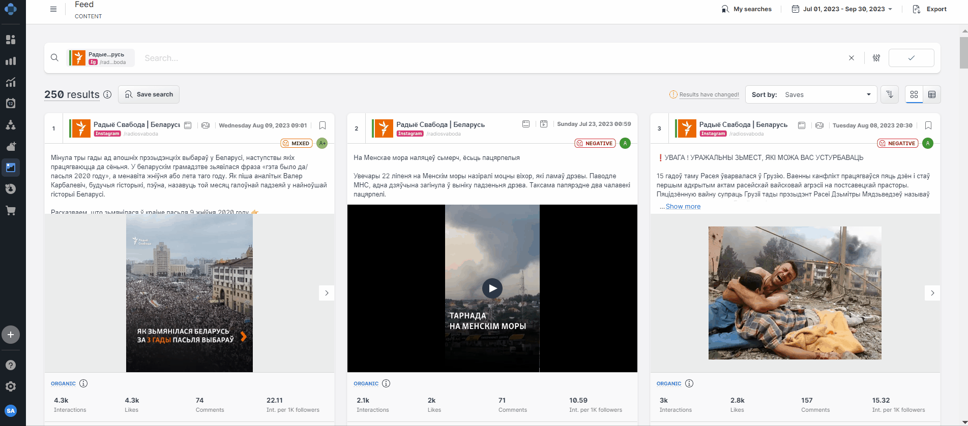
How to use the content hub:
Step 2b:
With this view, you can see individual posts & each post’s performance & in-dept metrics by clicking on it.
If you want to view the total values for each metric, switch to performance view and scroll through the metrics sheet.
You can see the sum totals as well as the averages for each metric.

Slide 18
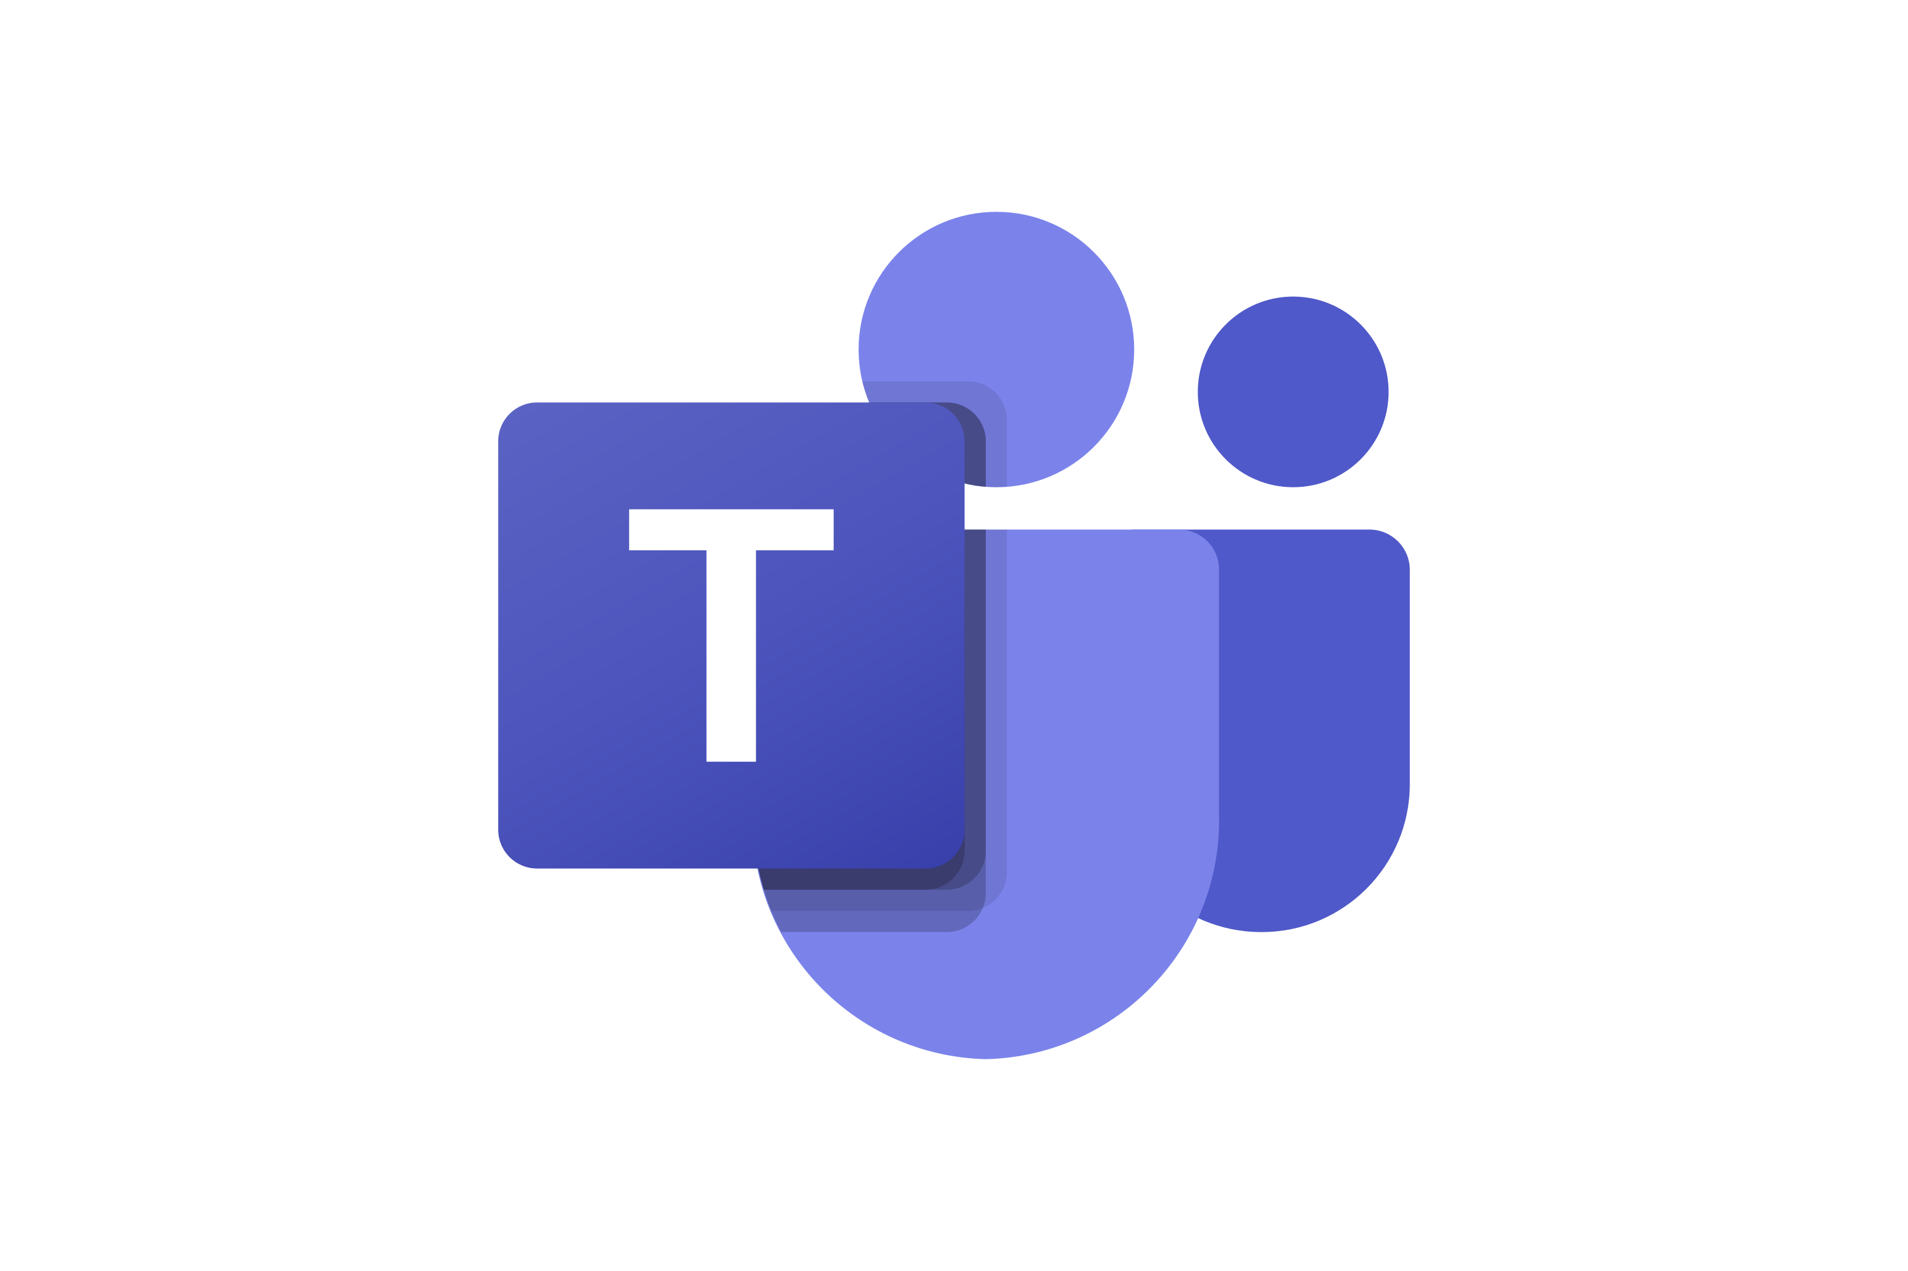
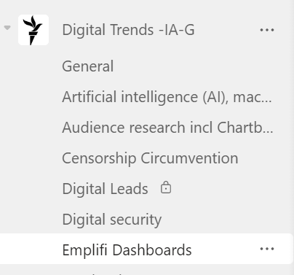
more questions?
Or reach out personally ☺
Ask a question on our Teams Emplifi Channel…
+ additionally, the rfe/rl academy is preparing a social media strategy on meta platforms course that will be available in late fall!

