Slide 1
@svobodnaevropa.bg
A success story
The TikTok account of the Bulgarian service

Slide 2
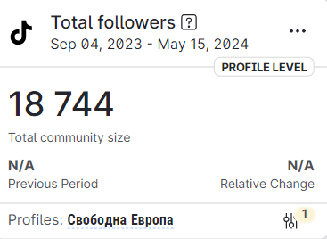
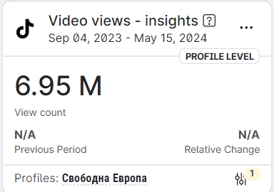
FLYING START
9 months
19 000 followers
7 million video views

Slide 3
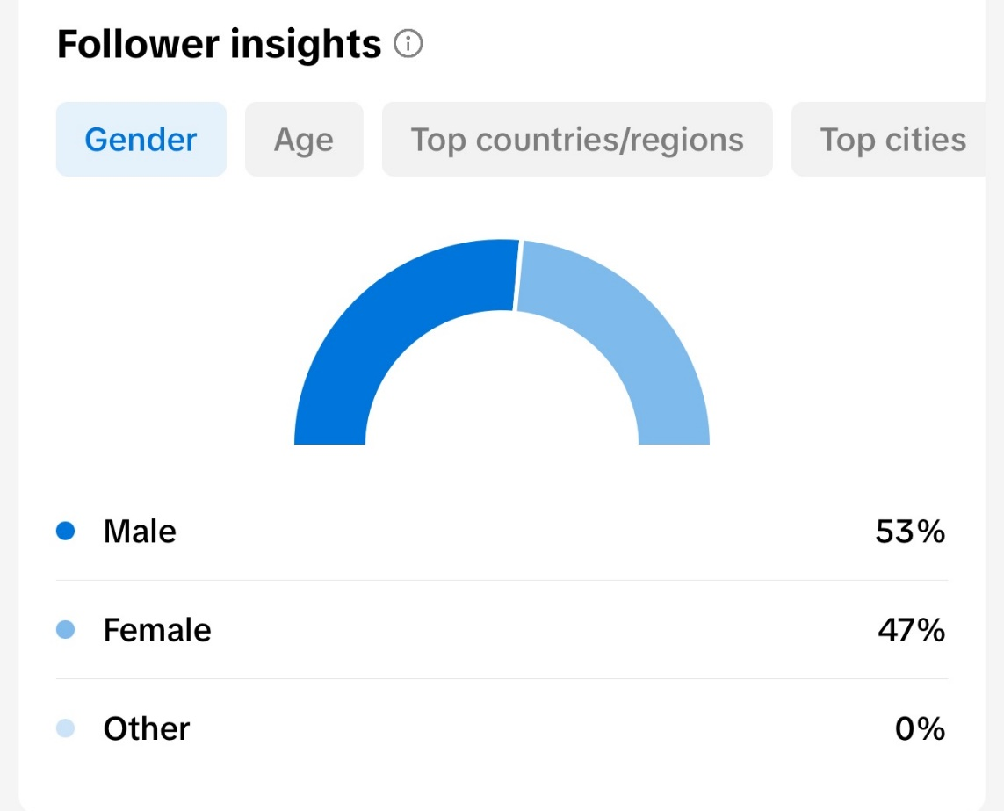
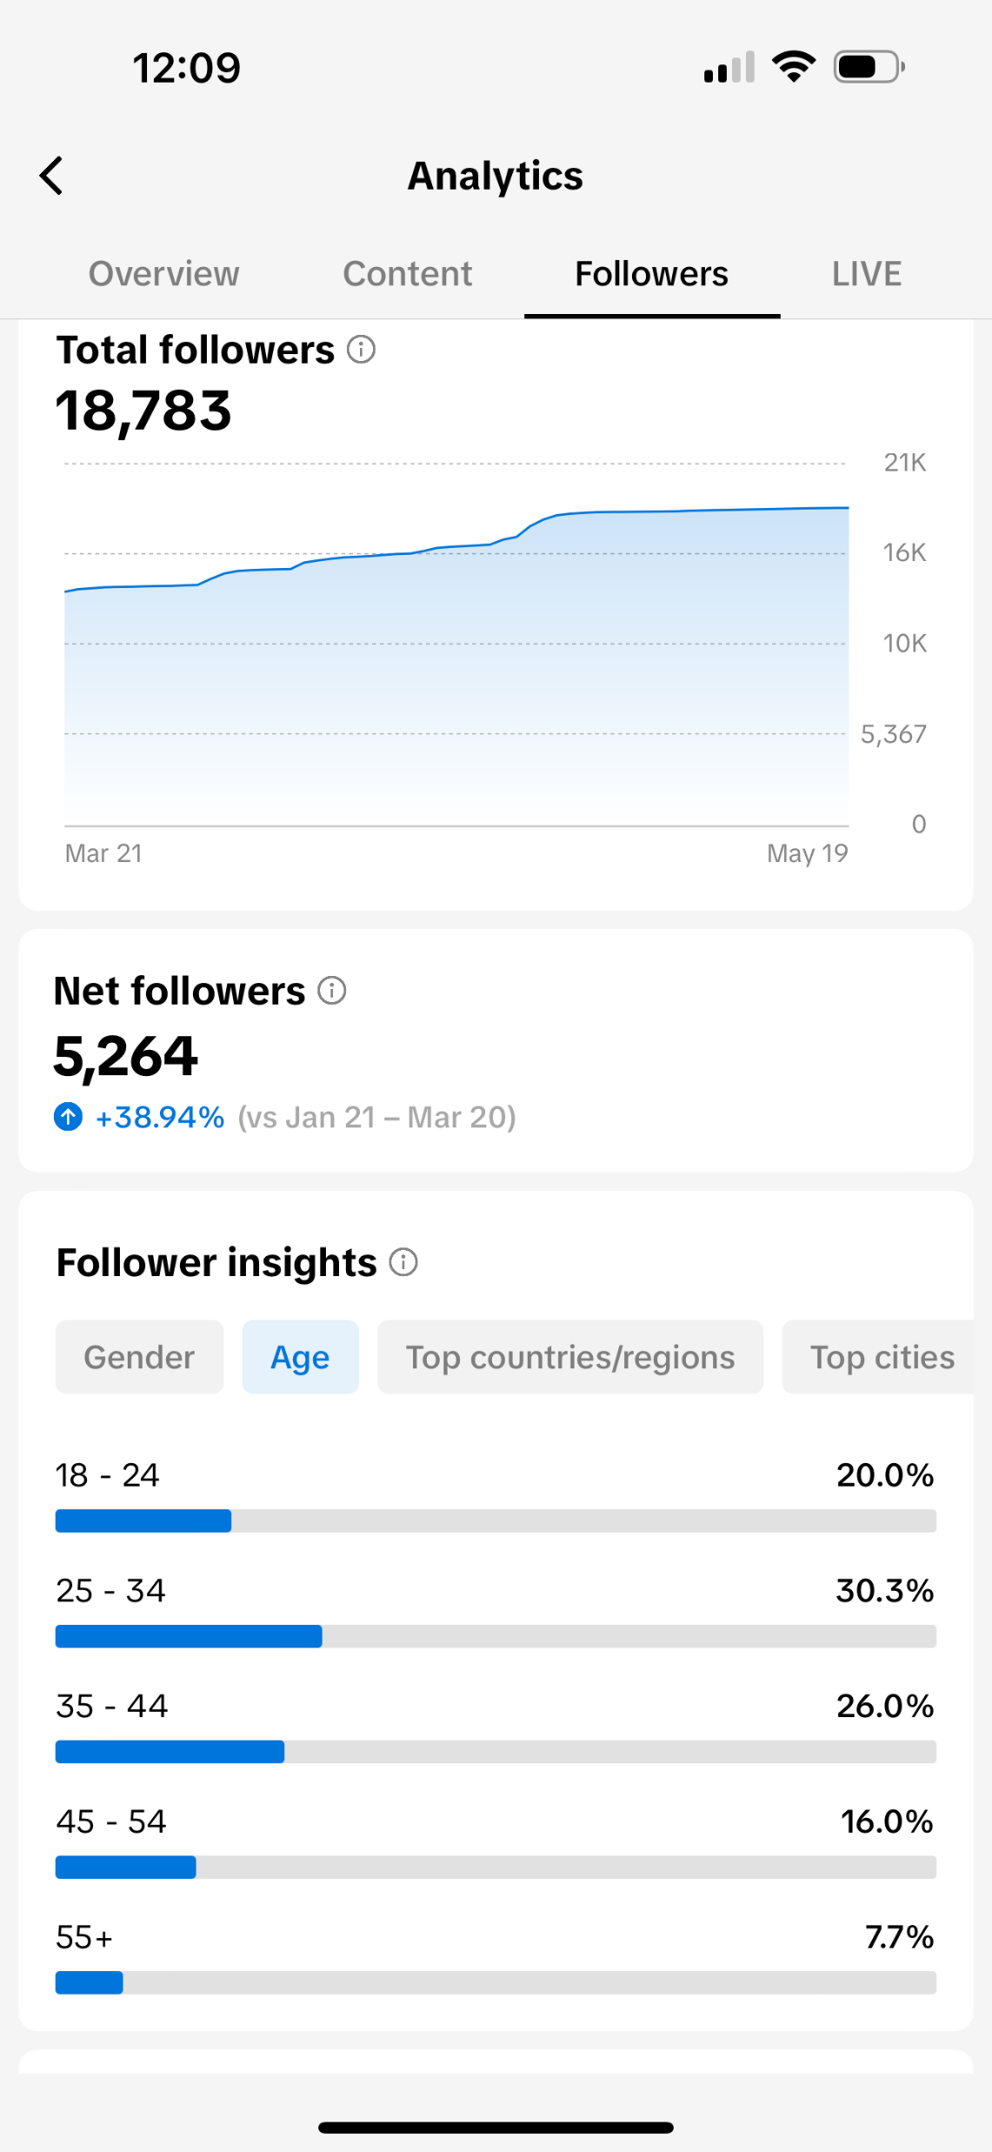
FLYING START
Young audience
Mission-related
Big news stories

Slide 4
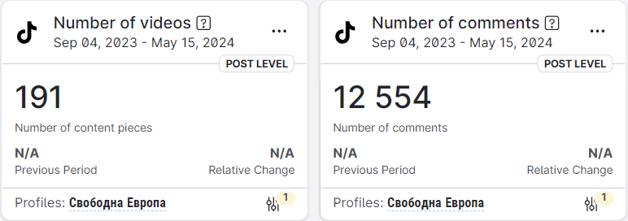
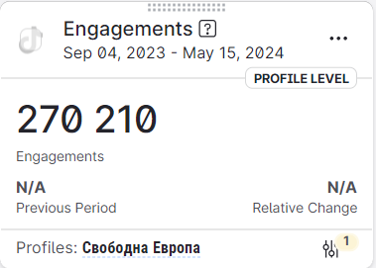
FLYING START
Fast growth
Organic only
High engagement

Slide 5
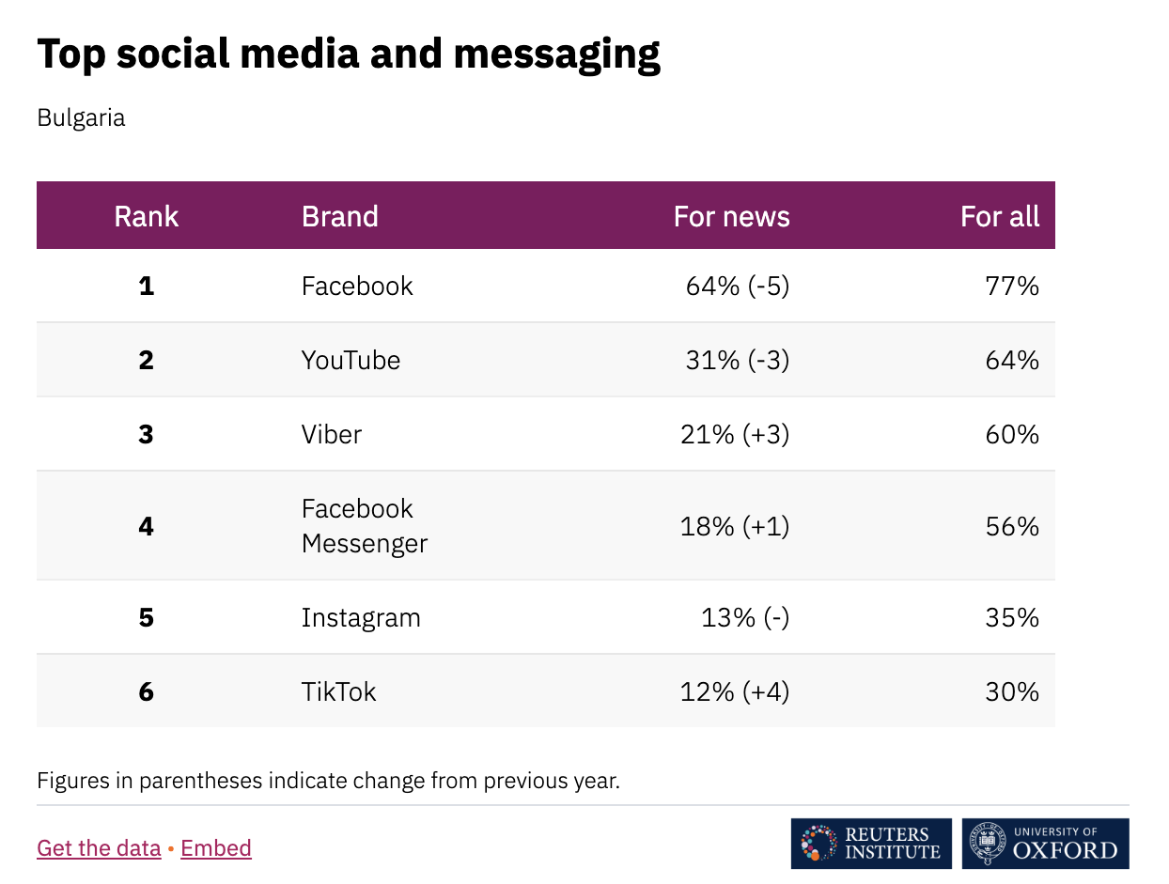
WHY USE TIKTOK
Small number of users
Fastest growing
Get in early

Slide 6
Preparation
Advice and training from the teams in Prague;
Planning with the team in Sofia;
Weekly plan for what to post and when;
Adobe Premiere template;
Older videos re-editing;

Slide 7
What works
Explainers
Vox Pop+
Who is ..... series

Slide 8
What works – Explainers
Example: What will change after Bulgaria becomes part of Schengen?
KEY CHARACTERISTICS
Led by a presenter;
Around 90 seconds in length;
Topical issue but not “News”;
Conversational scripting - short, simple sentences, easy to understand even if it’s complex topic;
Dynamic editing - jump cuts, movements, green screen, we have fun while making it;

Slide 9
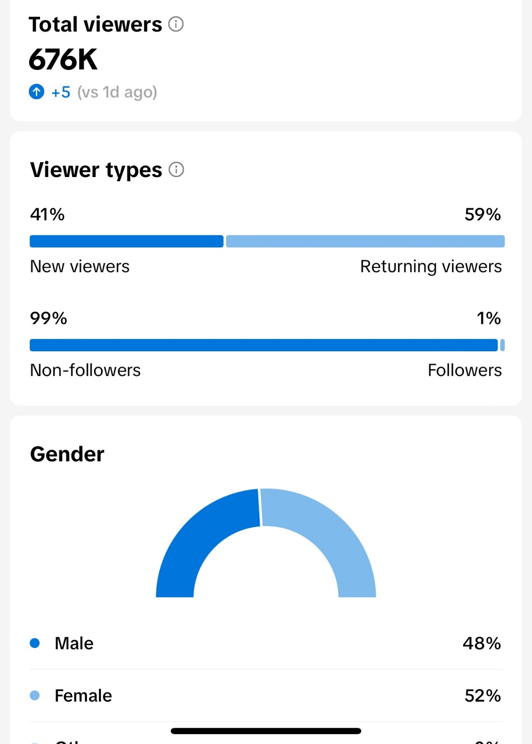
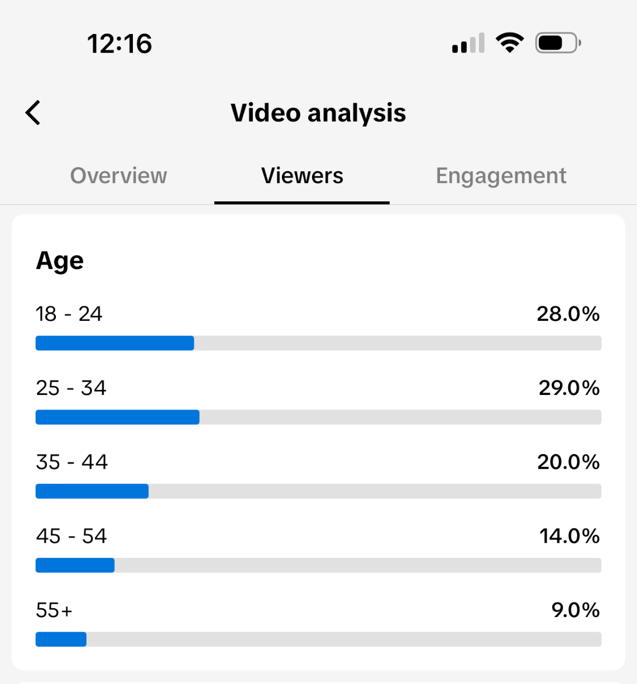
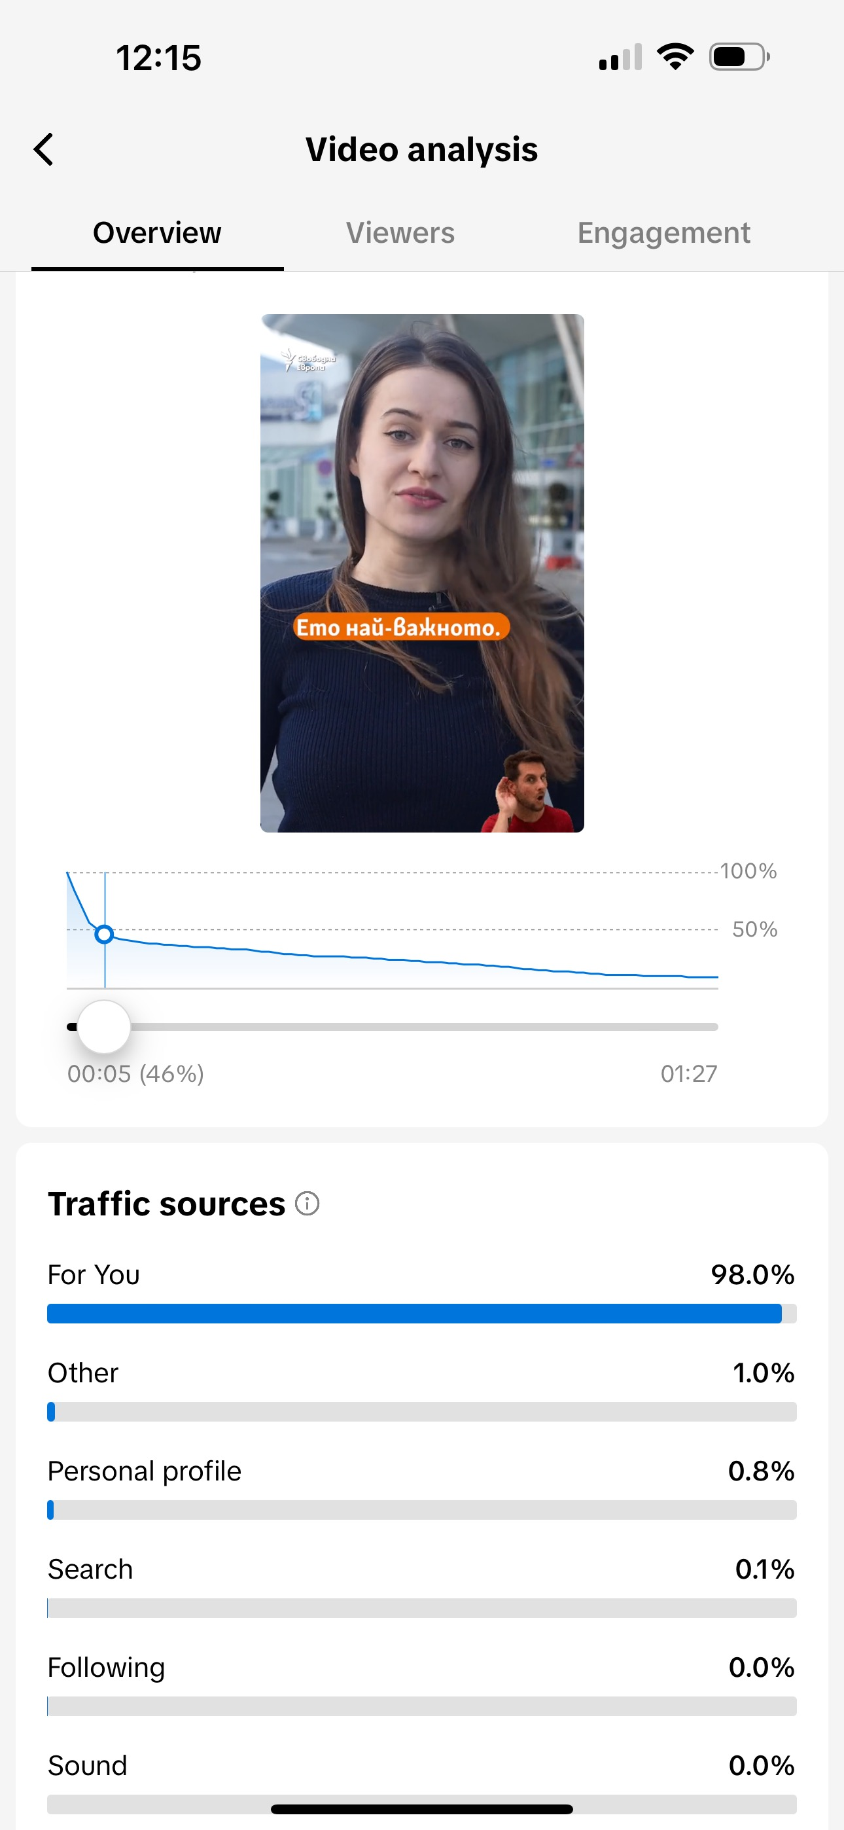
Example explainer analytics

Slide 10
Other topics for explainers that work
Series – “Who is …..”
about people currently in the news that you might not know much about; Example - Who is the Wolf
Topics that are important to STUDENTS:
  What do we need to know about the Whooping cough? – the virus spreads in schools;
  How many days can I take off school for family reasons?
  How do I file my annual tax document?

Slide 11
What works – Vox Pop+
Example: What do you think about the removal of the Soviet army monument
KEY CHARACTERISTICS
The answers are balanced;
2-3 TITLES with context and background;
Reporter appears briefly;
Around 60-70 secs in length;
Call to action;
Quick and easy to make;
A lot of views and engagement;

Slide 12
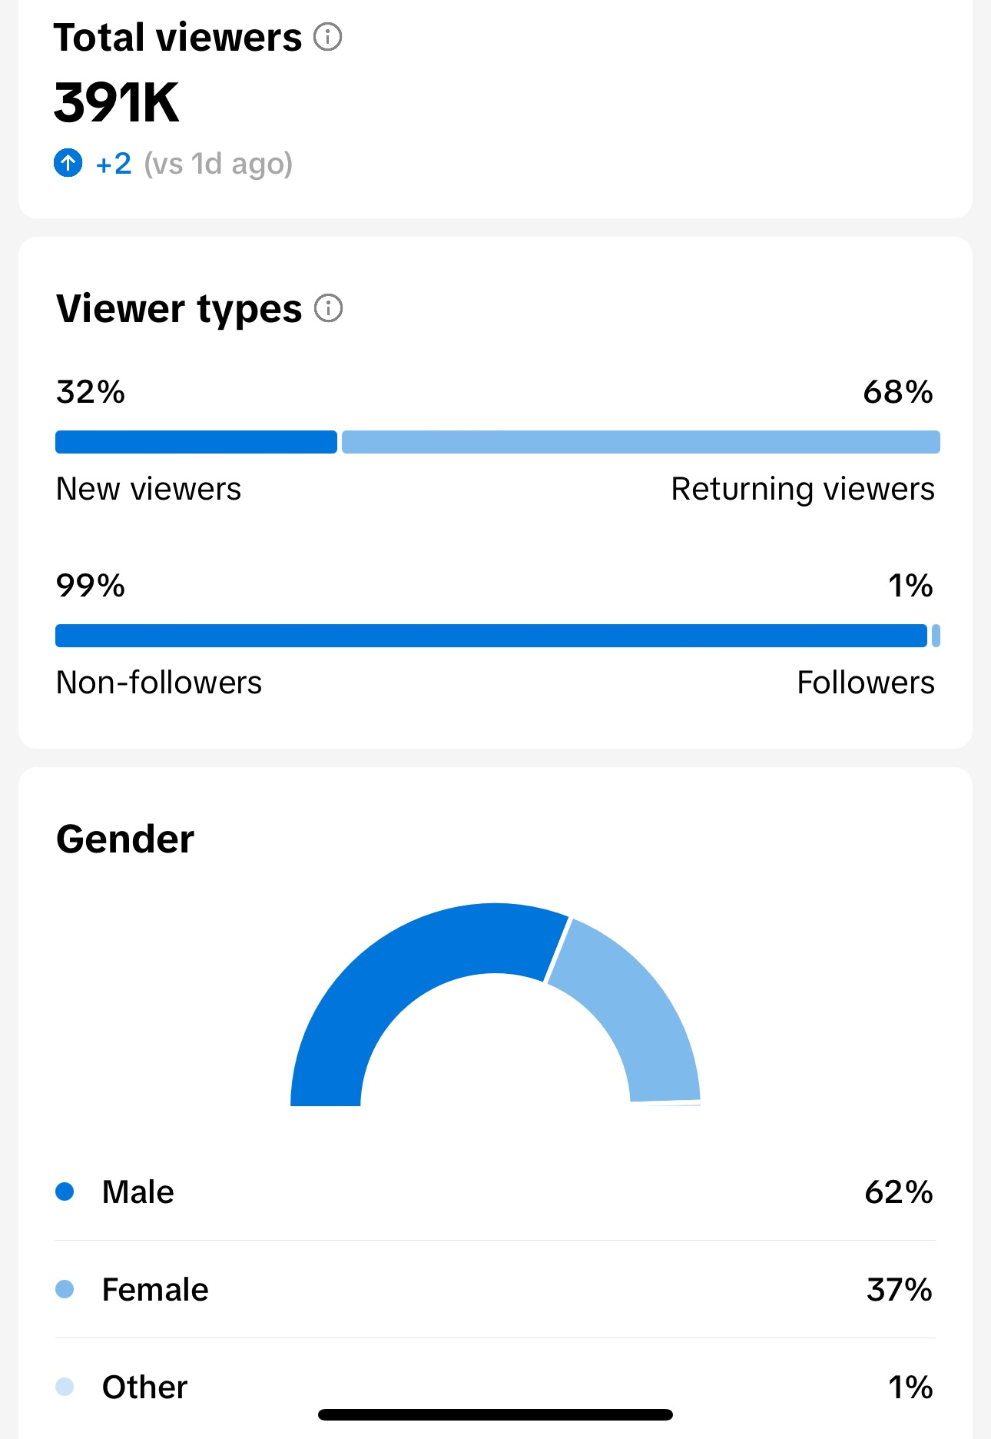
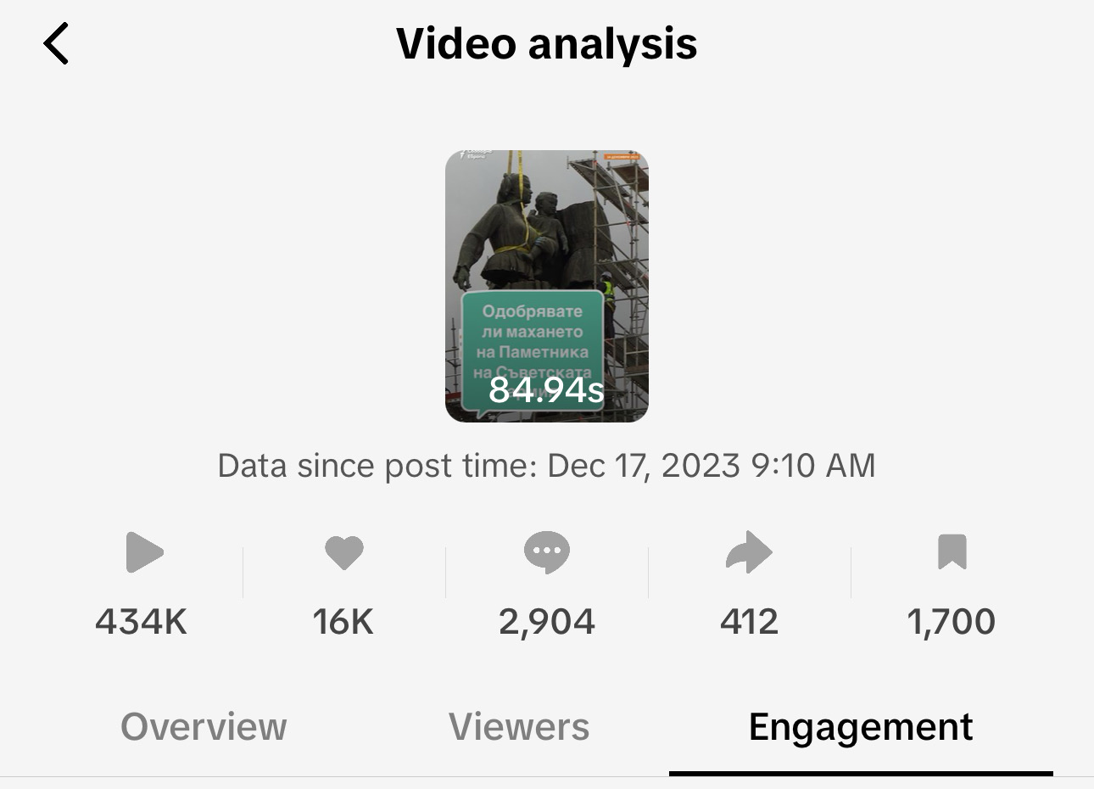
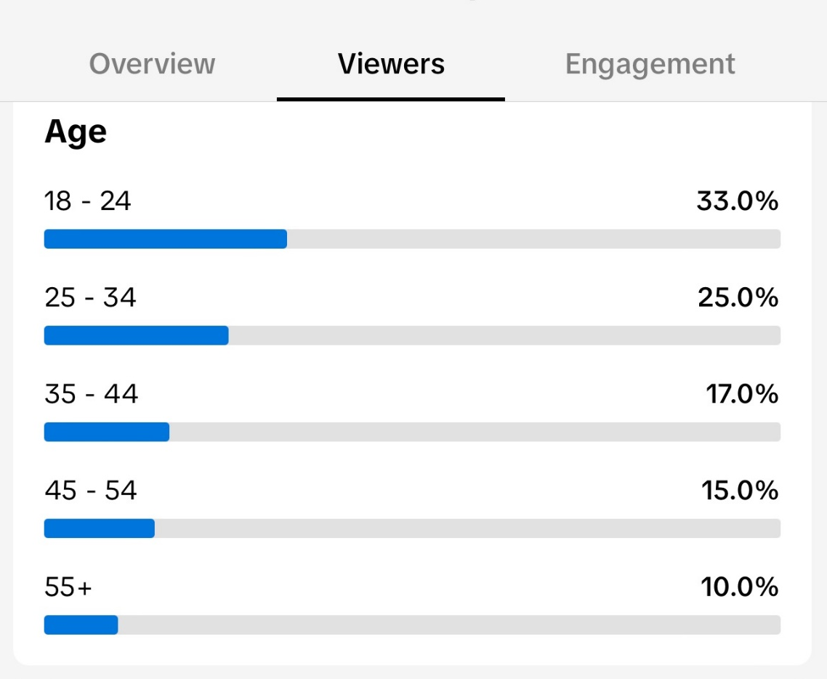
Example VOX POP+ analytics

Slide 13
What else works
Short soundbites from Studio interviews + context and background;
News-related videos;
Topics that interest the audience:
politics and mainly individual politicians,
EU - pro and anti sentiment,
communism and Russian legacy,
corruption,
the mafia
AND videos helpful to students

Slide 14
WHAT DOESN’T WORK FOR US
Quizzes
Long-form videos
Different topics than Instagram

Slide 15

What we found out about our audience
Two very different audiences
The quickly growing 18-34
The over 50s highly political

Slide 16
THANK YOU!

