Slide 1


Life After CrowdTangle: Using Alerts to Monitor Trends
Sandra Abdulhakova
Saba Chikhladze

Slide 2
CrowdTangle is going away
Monitoring Latest Content
1
Analyzing Content Performance
2
Understanding Market Trends
3

Slide 3
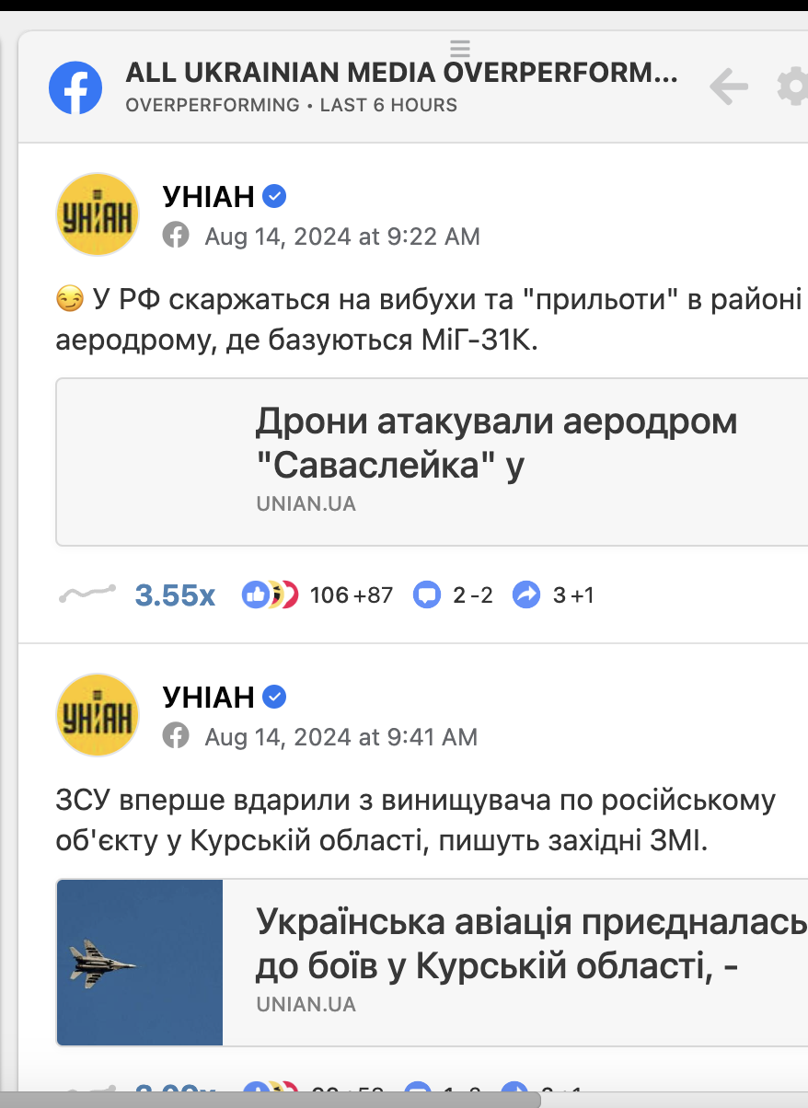
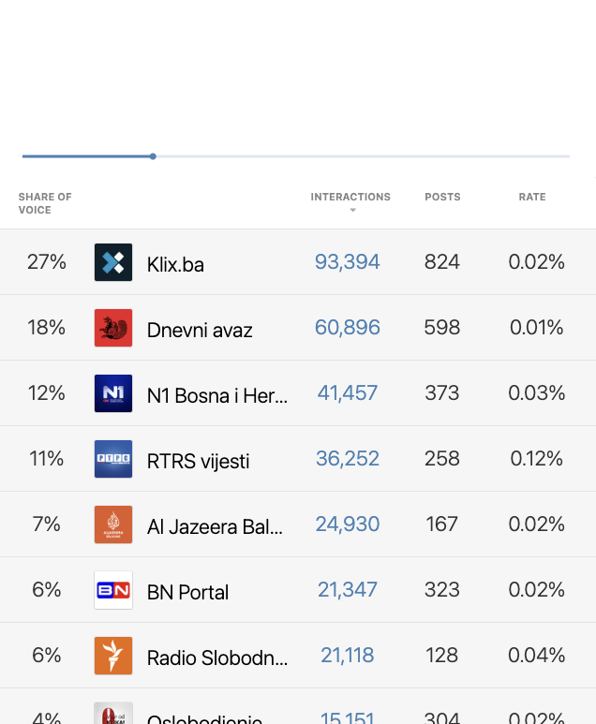
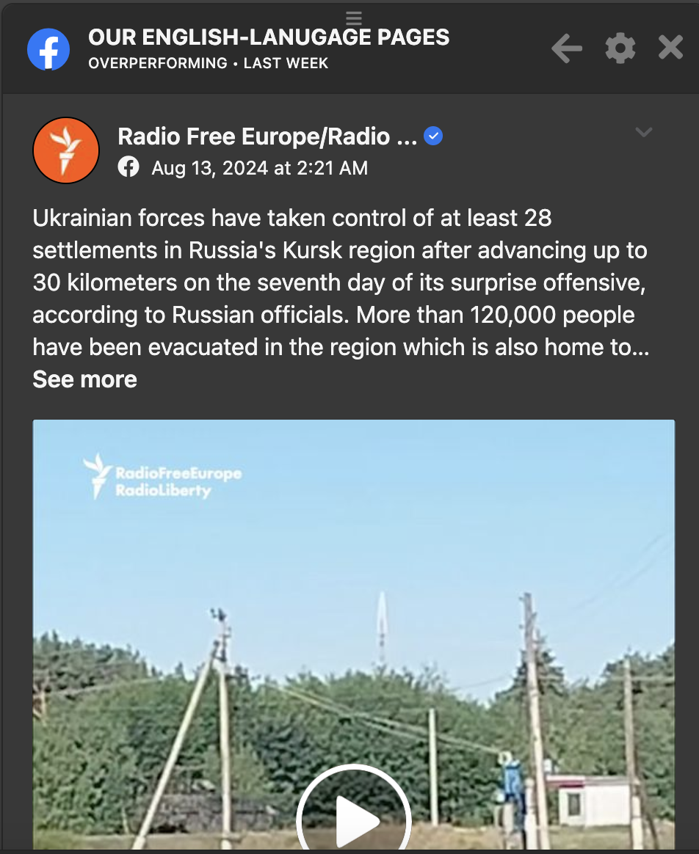
Market Trends on CrowdTangle
Live Displays
Overperforming/Underperforming content
Leaderboards

Slide 4

Understanding Market Trends
Quickly spot viral trends.
Identify emerging topics in the market.
Discover topics outside your usual focus.
Recognize unique content formats.
Compare your content with competitors.

Slide 5
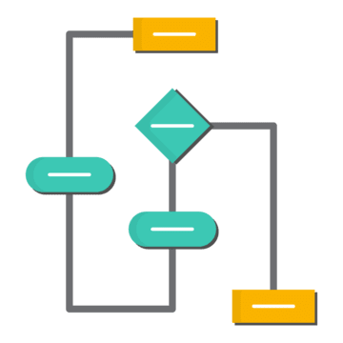
Scrolling isn’t enough to understand trends
Too many posts make spotting trends difficult.
Personalized algorithms show only what you’re likely to engage with.
Viral trends are often detected too late.
Limited view of the broader market landscape.

Slide 6
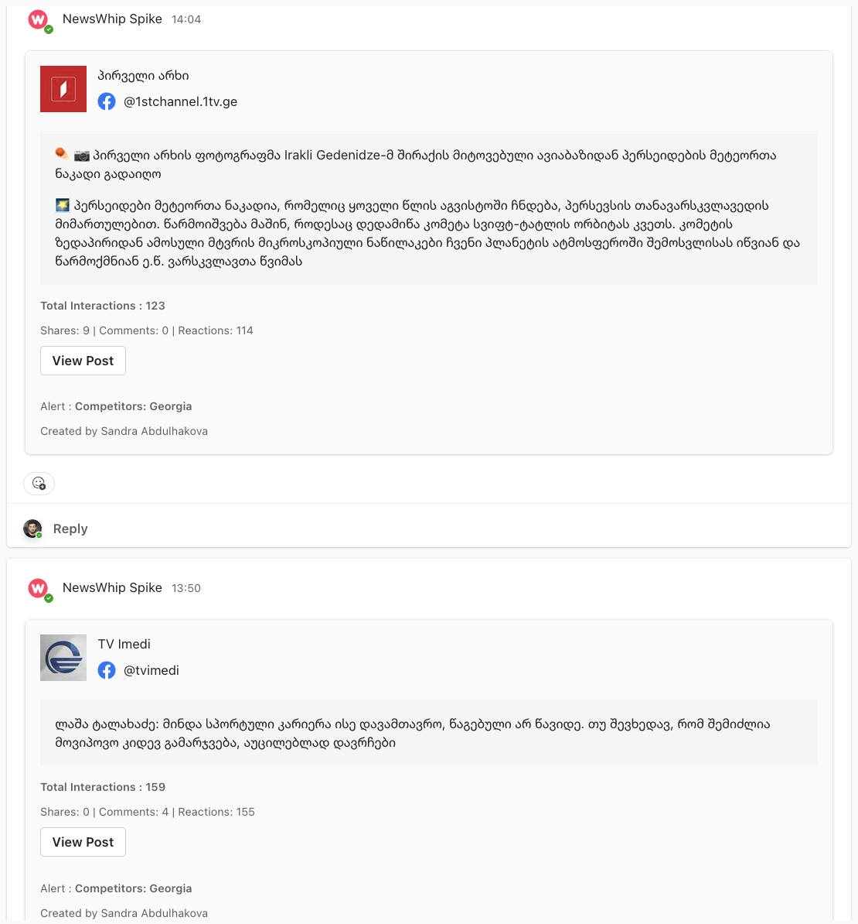

Introducing Viral Alerts/Spikes for your markets
Pre-set thresholds automatically detect spikes
Spikes from local markets are delivered to pre-created Teams channels.
Stay informed with timely notifications
Explore potential growing topics
Monitor competitors’ content topics and formats

Slide 7

CrowdTangle replacement but not in the traditional sense. No new app/platform.
NewsWhip will monitor over-performing posts in specific markets and alert us through Teams notifications.

Slide 8
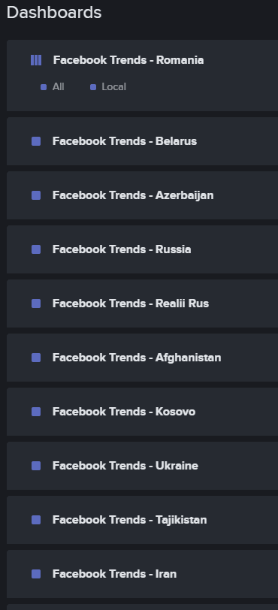
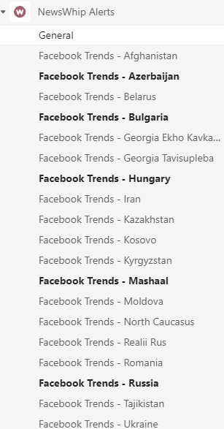
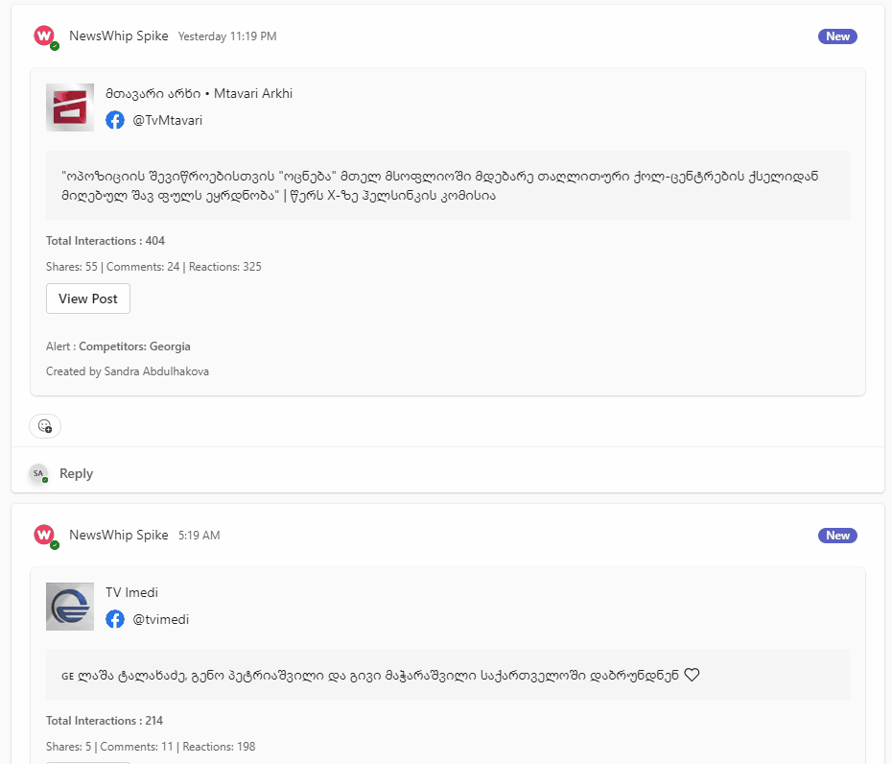
NewsWhip
Dashboards
Teams Channels
Alerts in Teams
NewsWhip dashboards are connected to Teams channels for each market where the alerts will be sent.

Slide 9

Alerts Filtration
All posts
Alerts for every post published will be too overwhelming. A filter must be implemented.
NewsWhip’s custom metric, velocity, ranks posts based on how quickly they become engaging. Every Facebook Page’s content has a certain average velocity.
Our alerts are set up to highlight posts that had a higher than average velocity within 3 hours of posting.
NewsWhip’s velocity threshold (the filter)
Over-performing post alerts

Slide 10
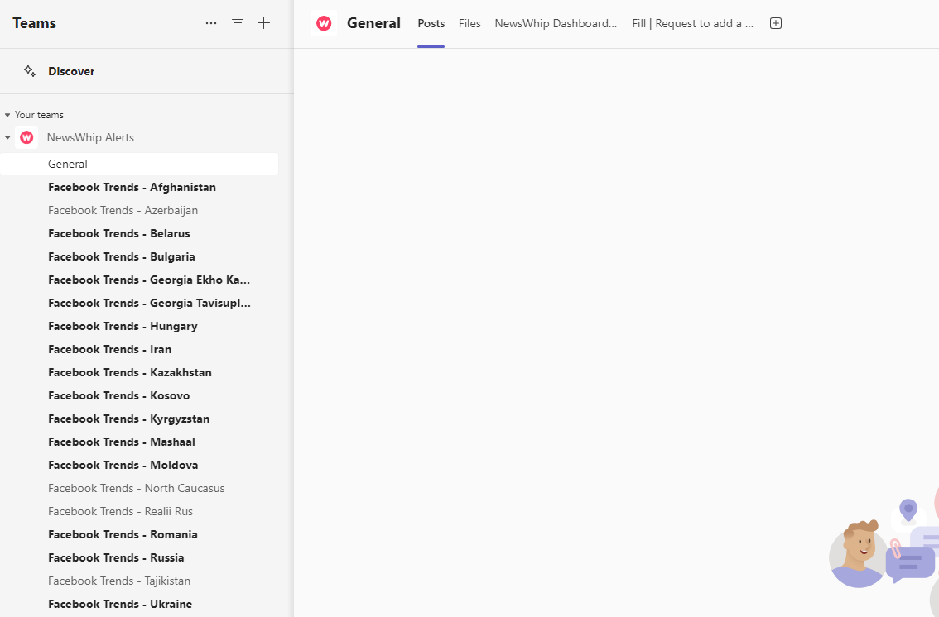
General channel for chatting, questions, etc.
Form for requesting adding or removing Facebook Pages to your alerts.
All the alerts are being sent to their respective market channel. Feel free to hide/unhide, mute/unmute as you see fit for your needs.
Excel sheet with an overview with all the Facebook Pages NewsWhip is tracking for each channel.

Slide 11
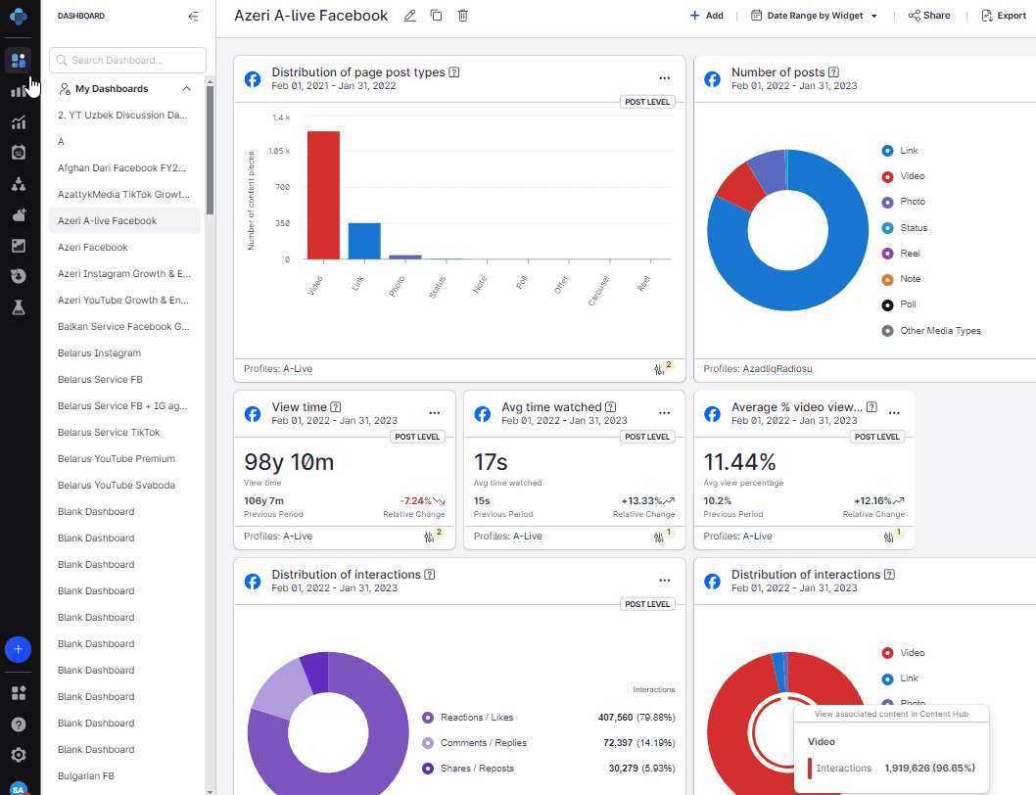
Emplifi: an archive of all published content on social media
Has a 1-day delay on Meta platform posts.
Can serve as an archive of all of RFE/RL and competitors posts via the Content tab.
Check what profiles we have in Emplifi here: https://app.emplifi.io/263993/settings/profiles
Check published content via Emplifi: https://scribehow.com/shared/How_to_use_the_Content_tab_in_Emplifi_to_check_published_content__jclRVJoRSCiMOwYvMJ1uVQ
Other Emplifi Tutorials: https://scribehow.com/page/RFERLs_Emplifi_Tutorials_and_Guides__KSWZ167tQWiHgegN3SUW1Q
If you need an account in Emplifi, get in touch with Sandra Abdulhakova.

Slide 12

Next steps:
19-23/8: Check in with the remaining teams that haven’t received an alerts channel yet.
26-30/8: Check in with the teams that have received their alerts channel, discuss their efficiency, and finetune the alerts.
2-6/9: Audience & Growth and News Products meet to address any remaining issues.
Questions? Ideas?

