Slide 1
TELEGRAM FOR NEWSROOMS 2024
RFE/RL NEWS PRODUCT TEAM
Saba Chikhladze
Alina Živanović
Kateryna Talikova

Slide 2
Why Telegram and messaging platforms?
Features
Video
Best practices

Slide 3


Why telegram
& MESSAGING APPS
Daily Usage for Private Communication:
Algorithm free environment
User interaction
Diverse content delivery
Direct and immediate communication
Community building

Slide 4
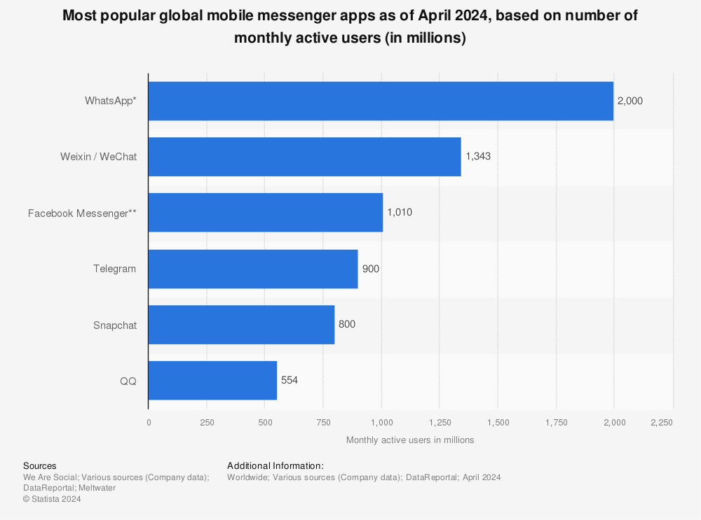
Messaging Platforms
In the world
Significant Number of Users
Popularity in Our Broadcasting Regions

Slide 5

WHY TELEGRAM?
Popularity in Our Broadcasting Regions
Telegram is widely used and well-regarded in the areas where we broadcast, ensuring that our content reach a large and engaged audience.

Slide 6

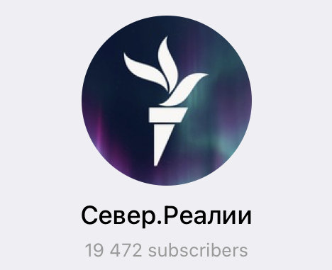
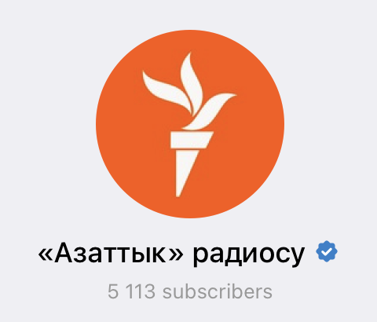
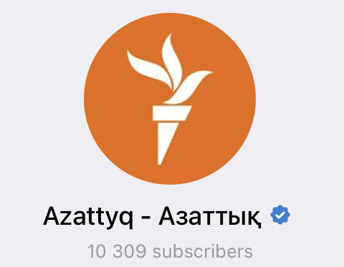
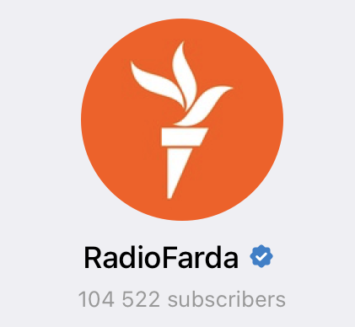
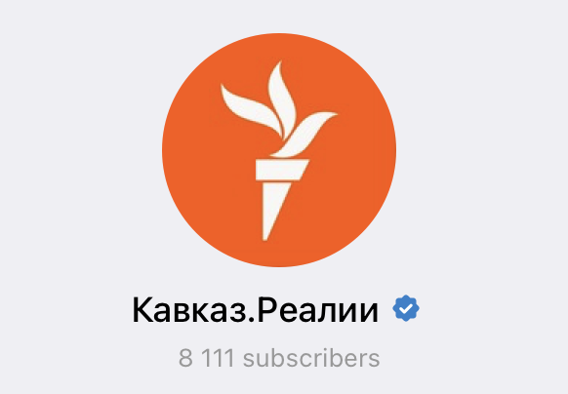
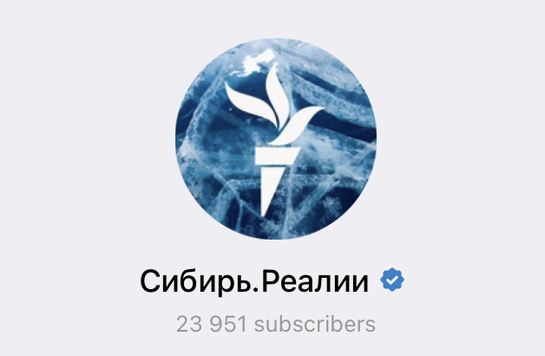
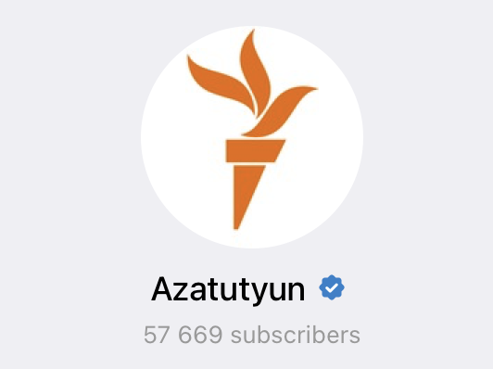
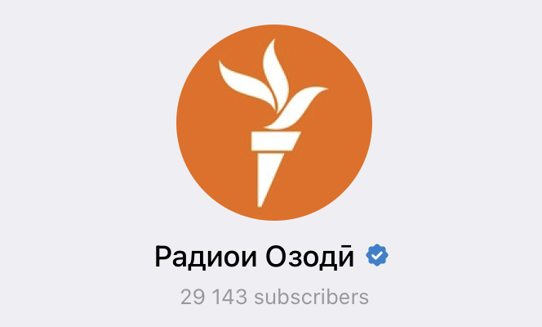
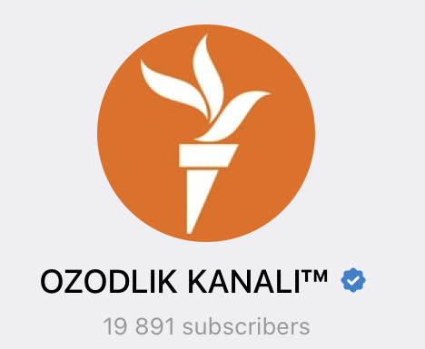
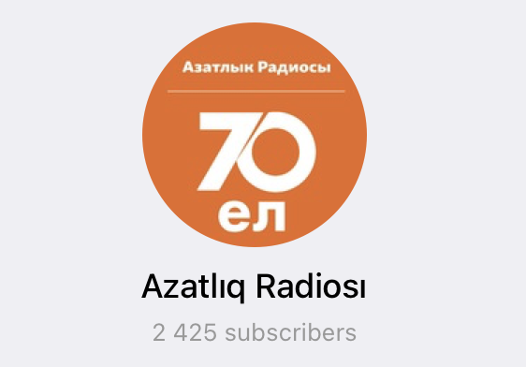
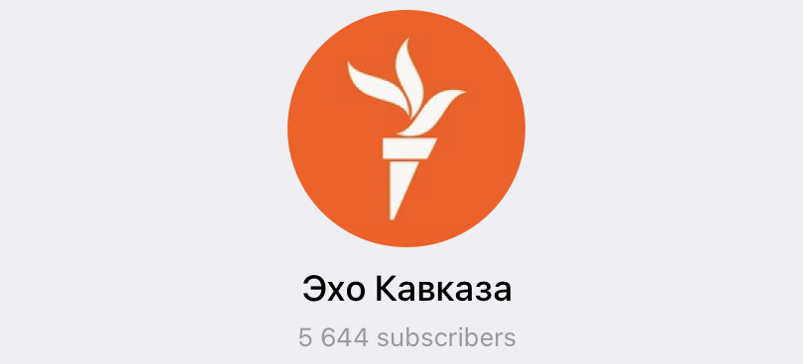

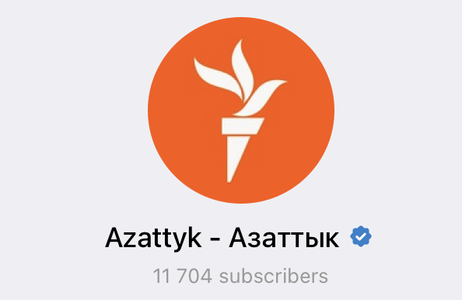
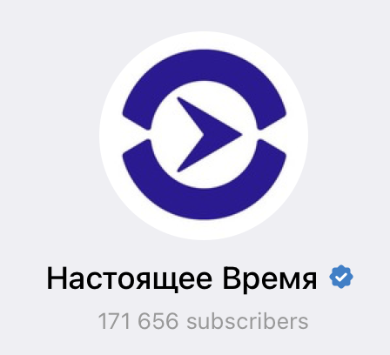
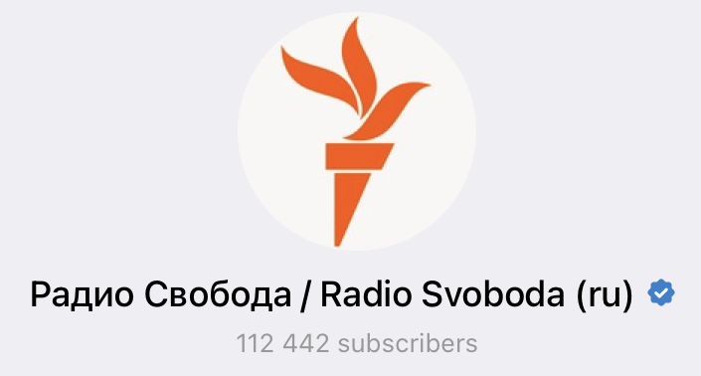

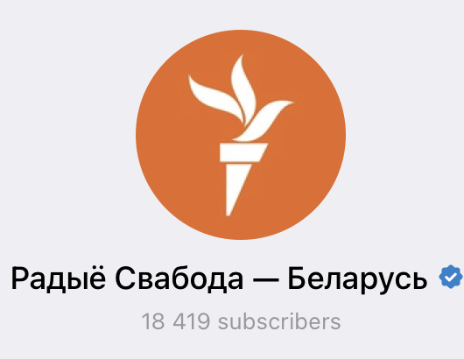
RFE/RL on Telegram
30+ CHANNELS
ABOUT 900K Subscribers

Slide 7
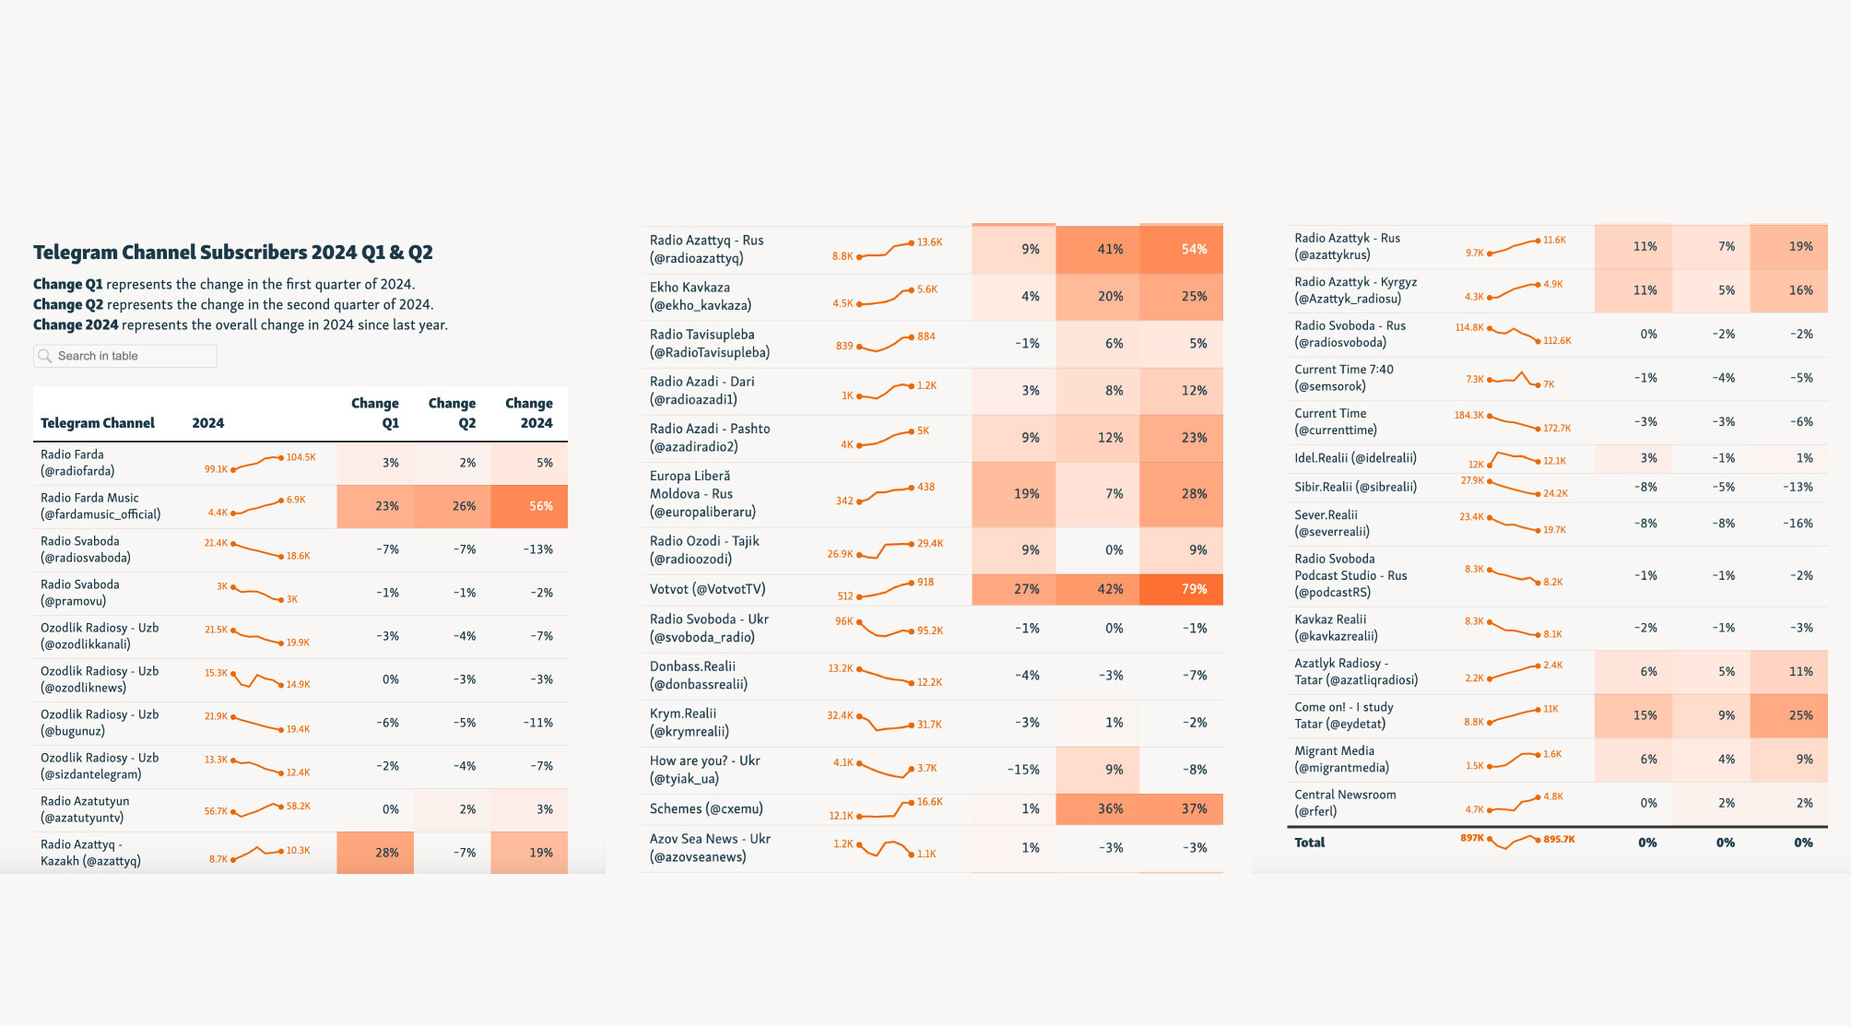

Slide 8

Key features:
  Channels
  Groups
  Bots
Key features for posting:
Variety of content types: Video, Text, Audio.
Text Formatting
Reactions
Polls & Quizzes
Pinned messages
Discussions / Comments

Slide 9

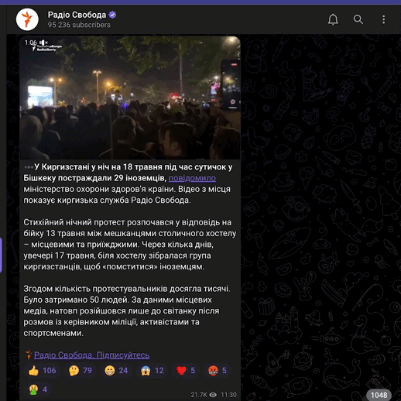
VIDEO CONTENT
Regular videos are illustrative content for the text post
Telegram native aspect ratios: 1:1, 16:9
Video file compression: up to 22,5 MB
Text post is short and concise
There is no thumbnails for video

Slide 10
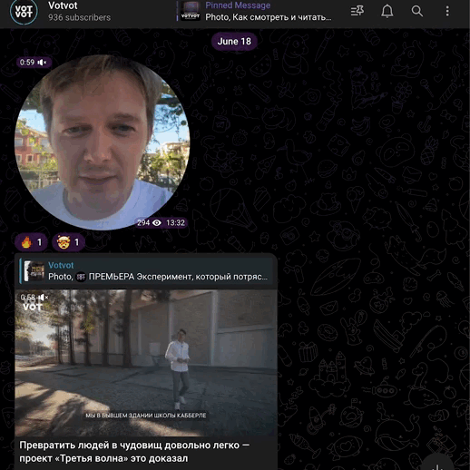
VIDEO MESSAGES
Circles are TG native video format
It is possible to convert master videos into circles
Duration: up to 1 min
Great for content promotion
Great for on the ground coverage

Slide 11

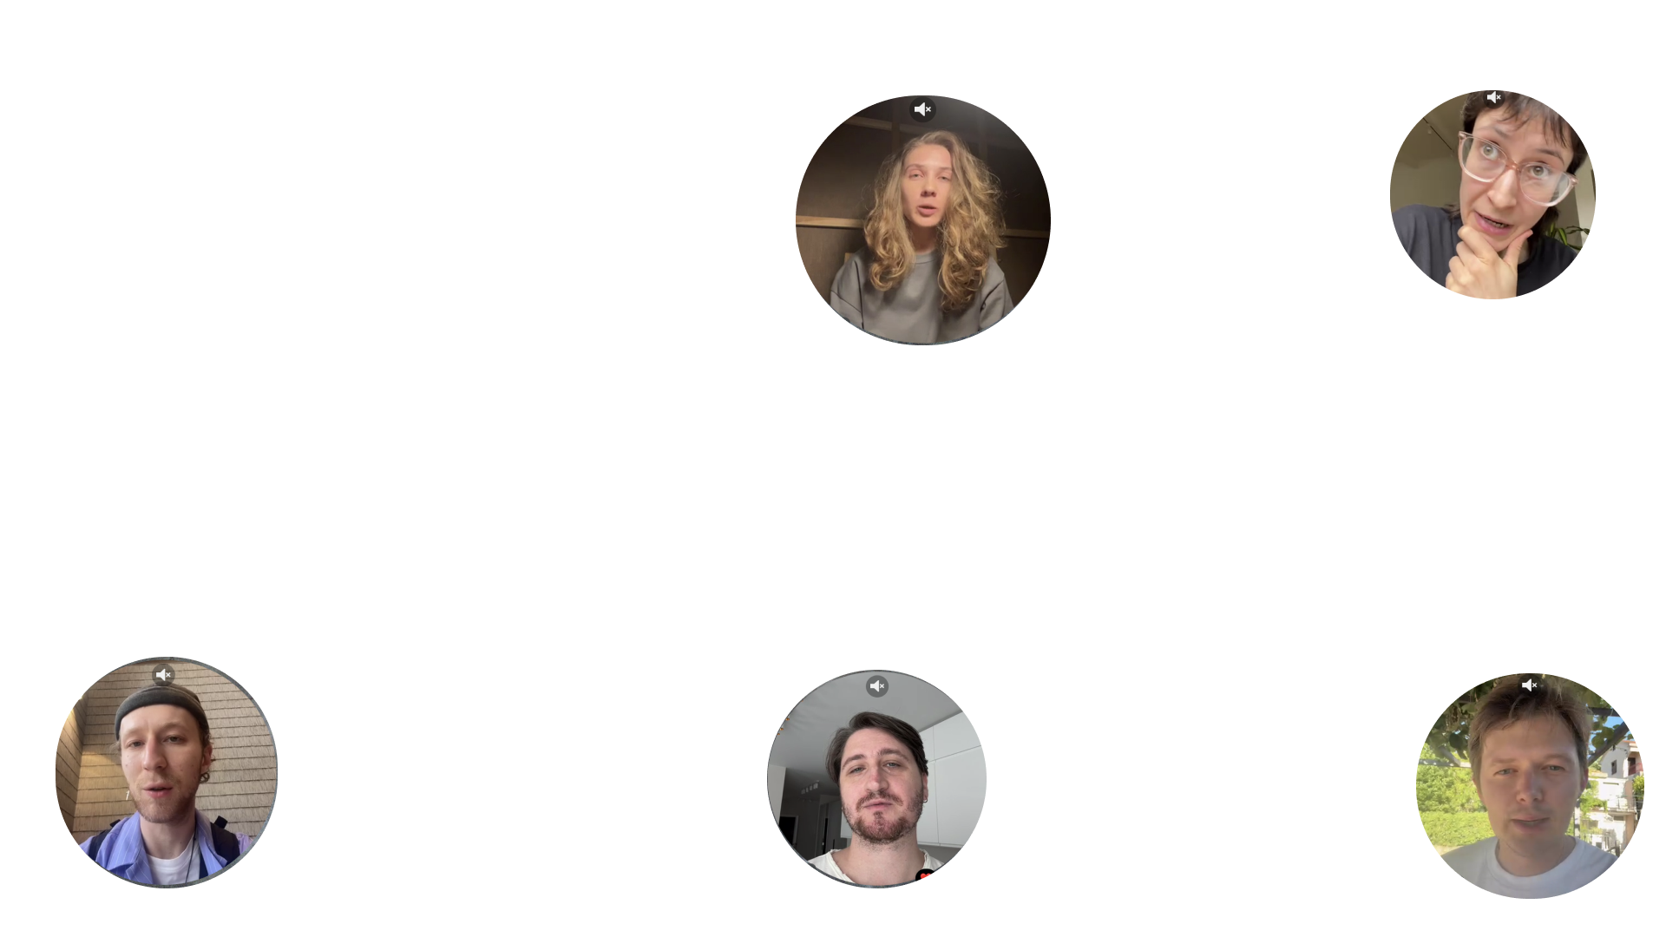
  REASONS
  TO USE
  CIRCLES
  USES
  Great method for releases and premiere
  Short format featuring a personal touch
  Simulation of 'close interaction'
  Ease of recording
  For promo texts and videos
  For podcasts and music

Slide 12
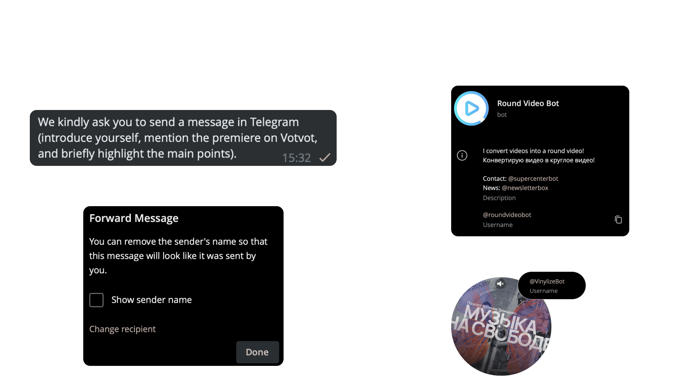
  INSTRUCTIONS
12

Slide 13
Best PRACTICES

Slide 14
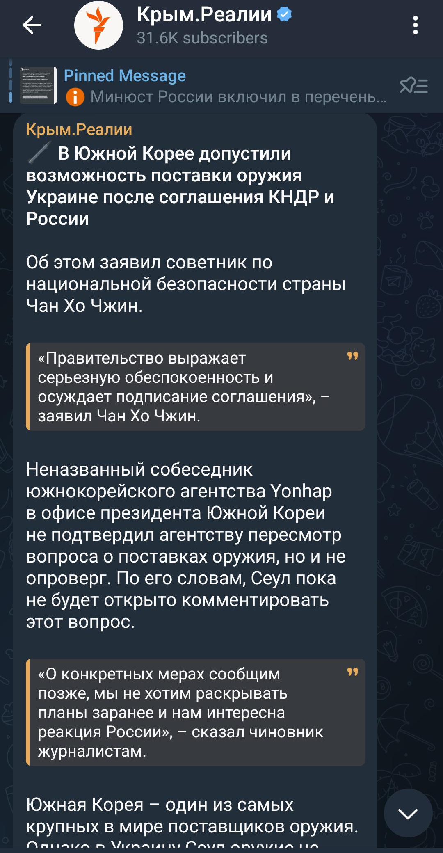
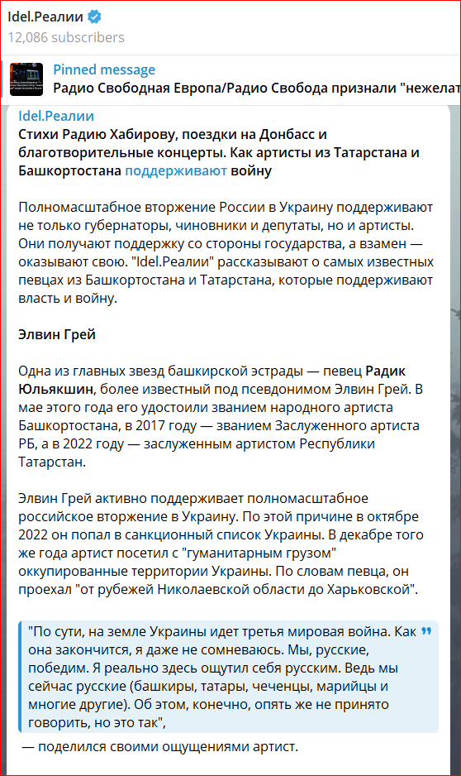
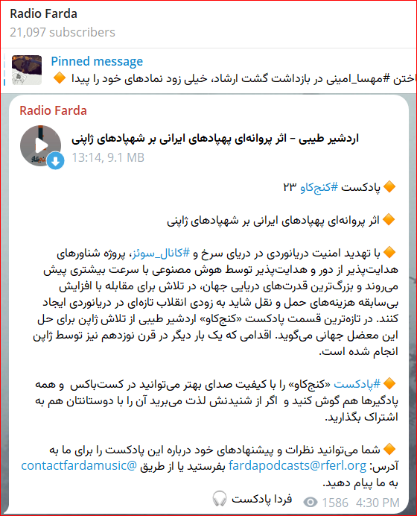
Formatting
Paragraphs
Quotes
Bullet points

Slide 15
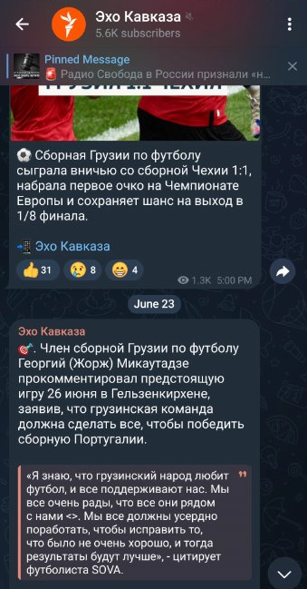
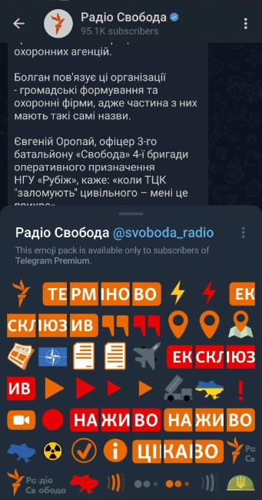
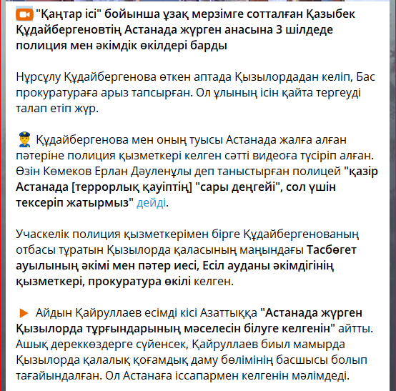
FORMATTING
Bullet points
  Static emojis
  Animated emojis

Slide 16
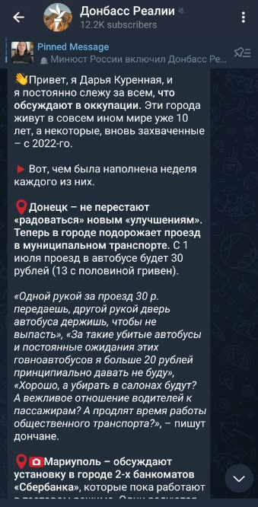
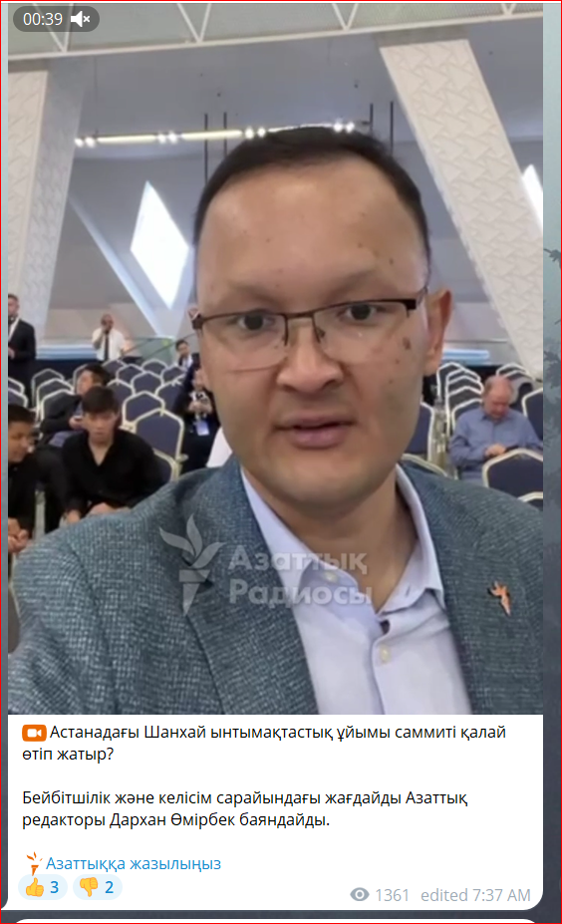
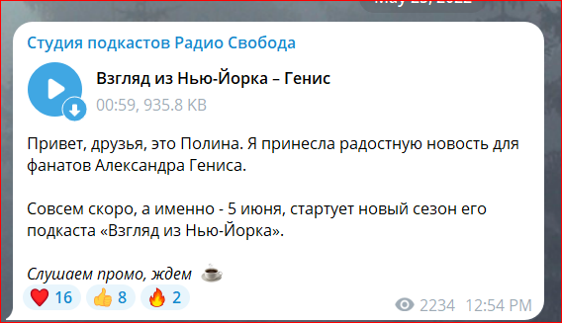
Direct personalized tone
As an author
As a newsroom
As a guest

Slide 17
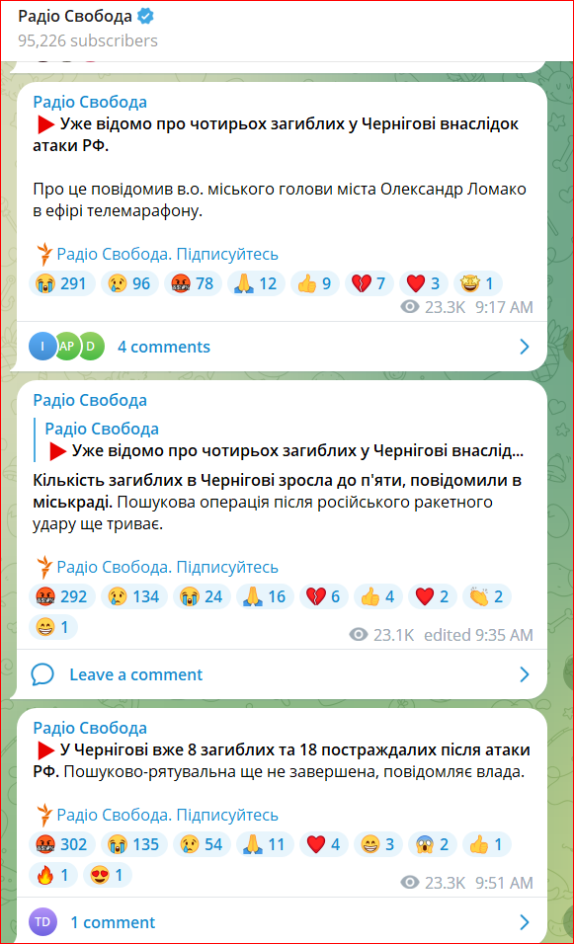
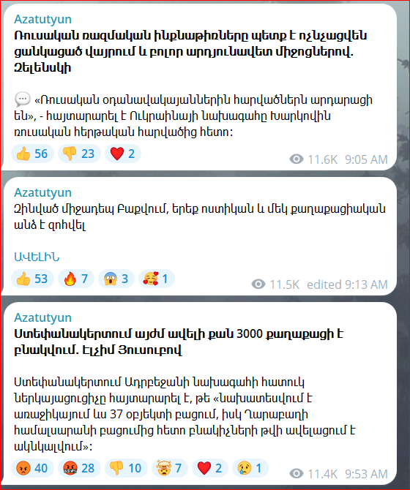
Text updates
Can be just text without images.
For formatting use emojis

Slide 18
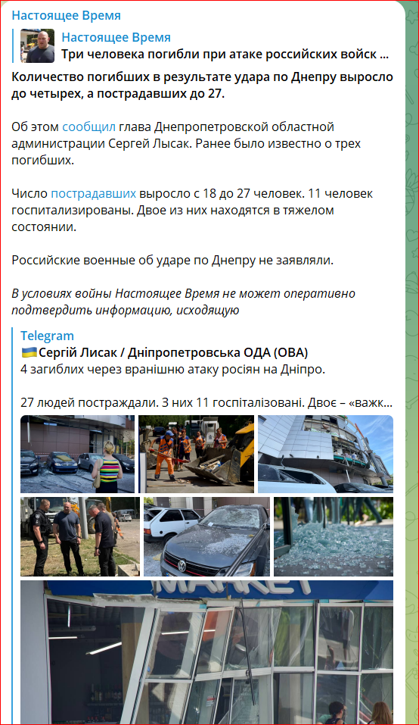
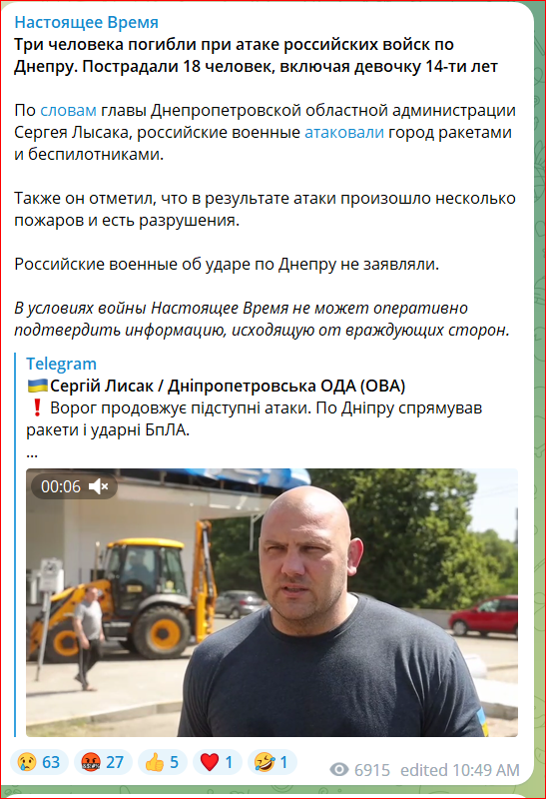
follow ups
Quote the initial post
Provide updates
Link the source

Slide 19
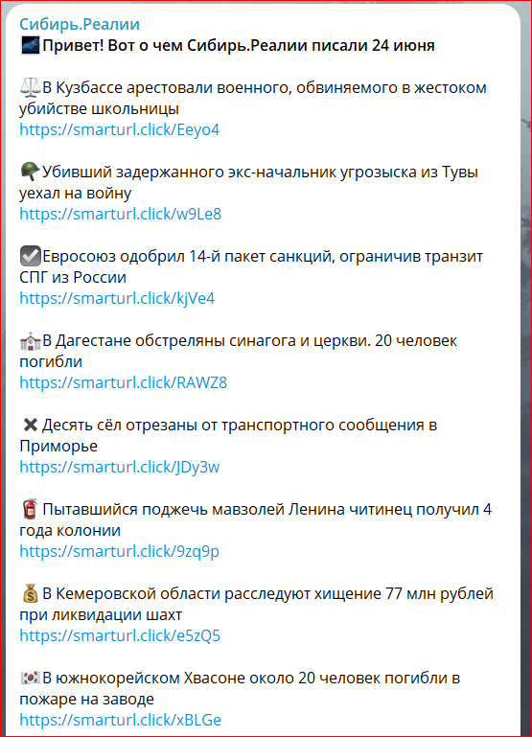
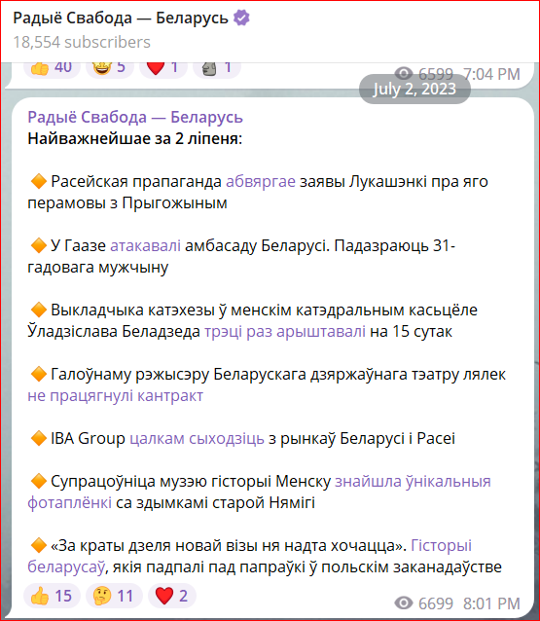
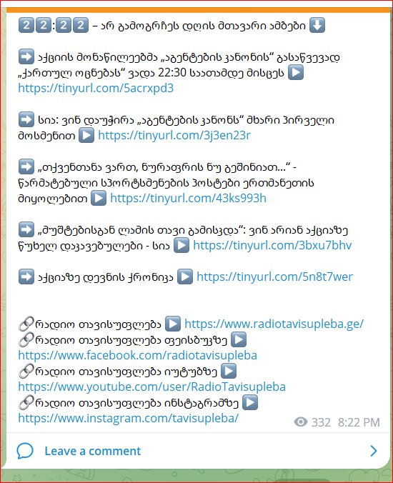
digests

Slide 20
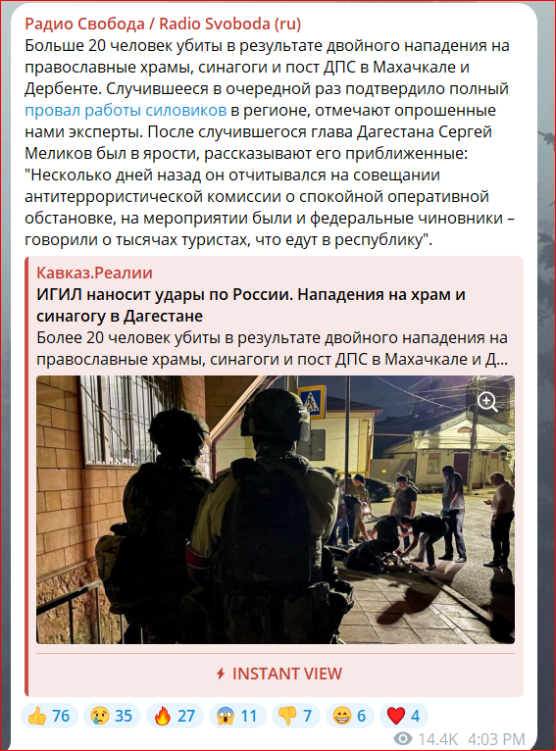
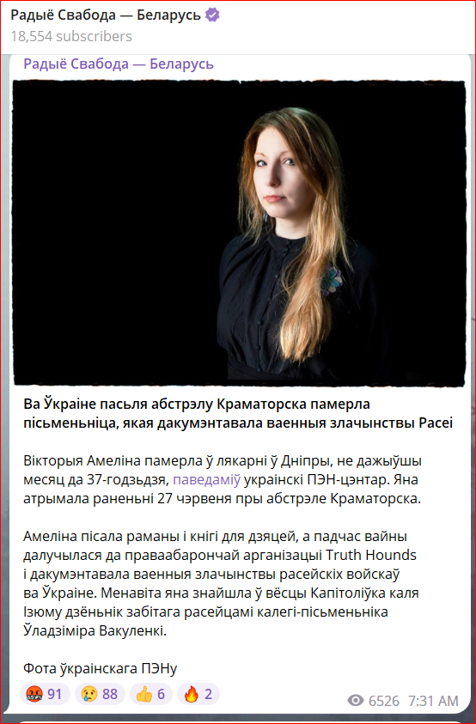
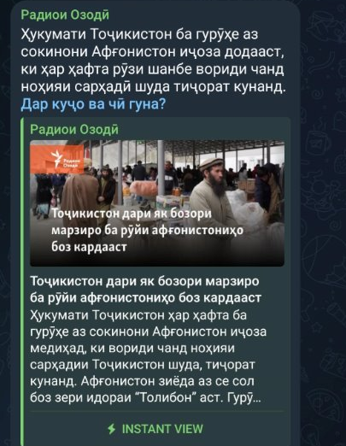
POSTS WITH Links
To other RFE/RL newsroom's website
To own website

Slide 21
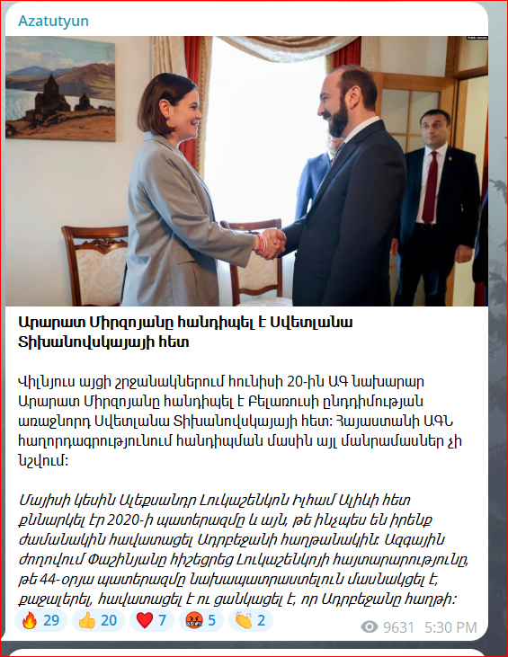

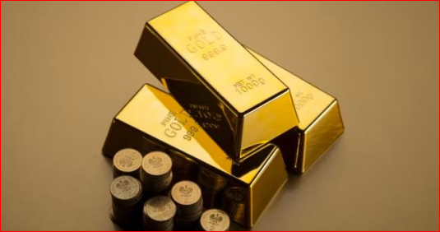
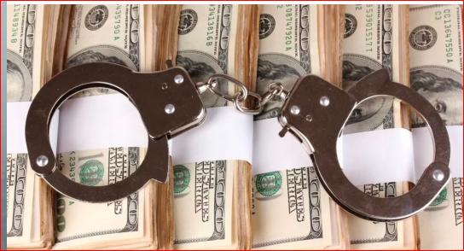
IMAGES
Use of images
    Avoid excessive use of
    illustrations if there is no added value to it
    Just text sometimes is fine
    For formatting / separating posts paragraphs,
    emojis can do the job too

Slide 22
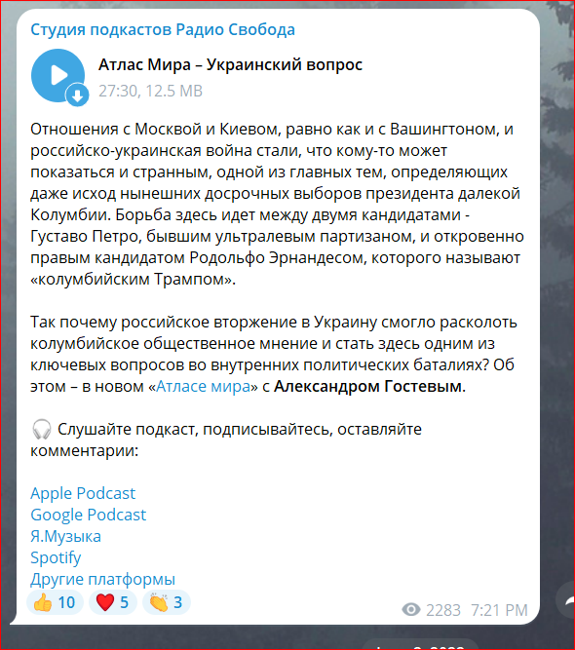
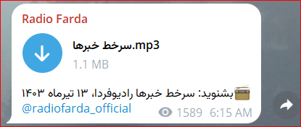
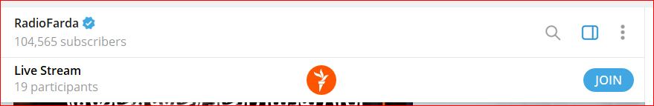
AUDIO
t

Slide 23
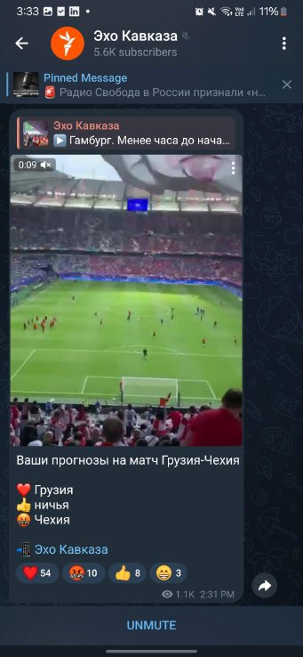
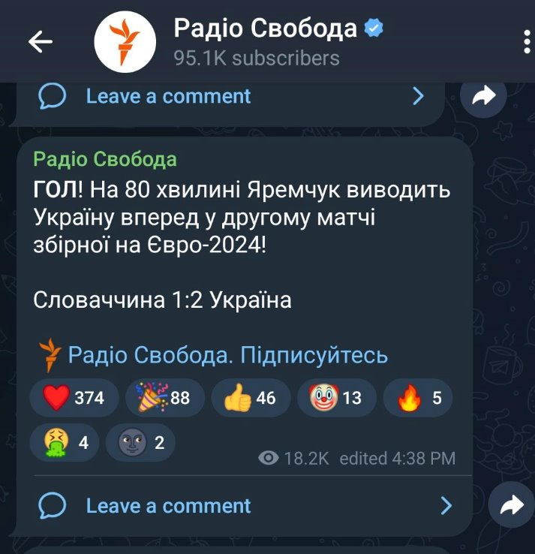
INFORMAL notes/ UPDATES
Why not? Biggest news in the country at the moment. Messengers are less formal channel

Slide 24
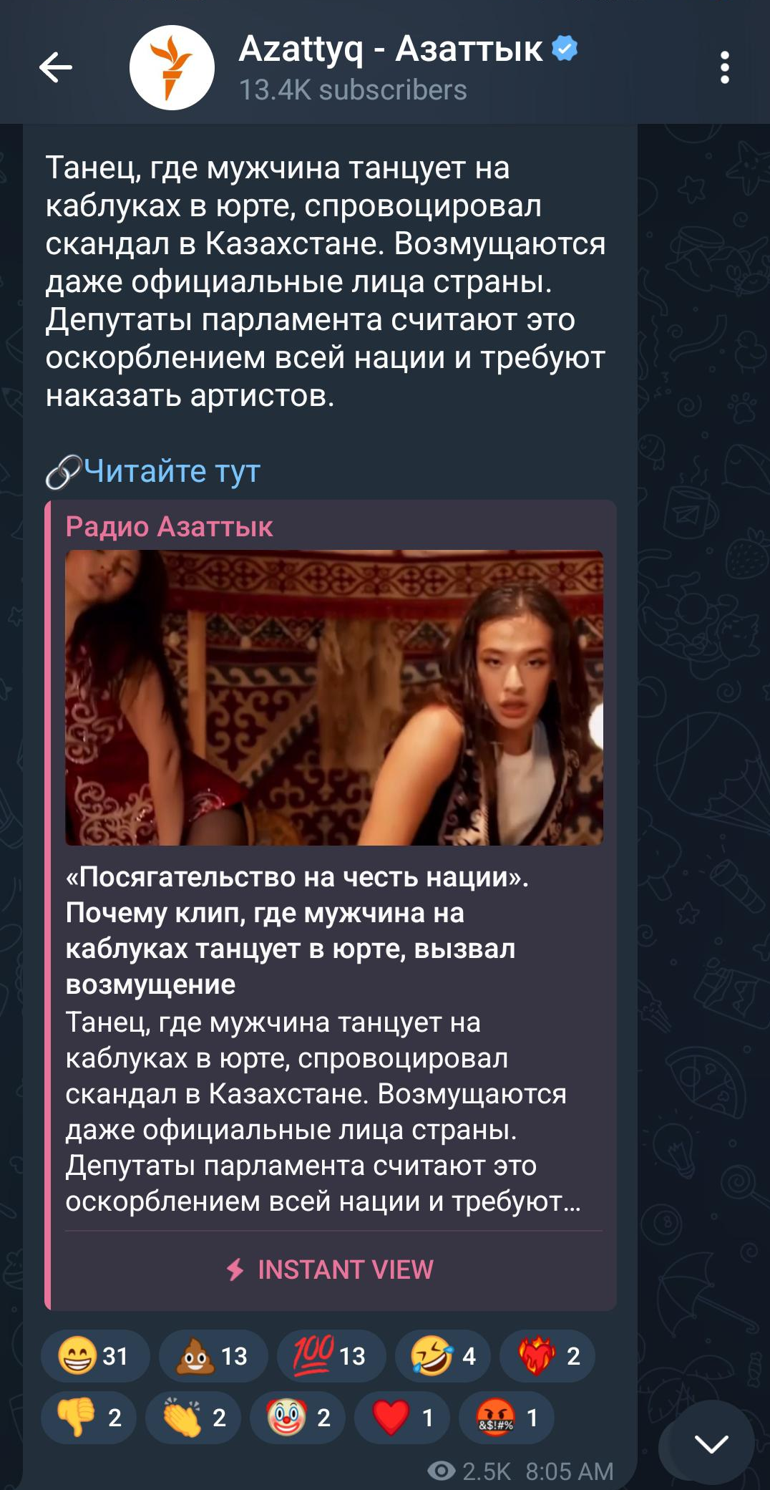
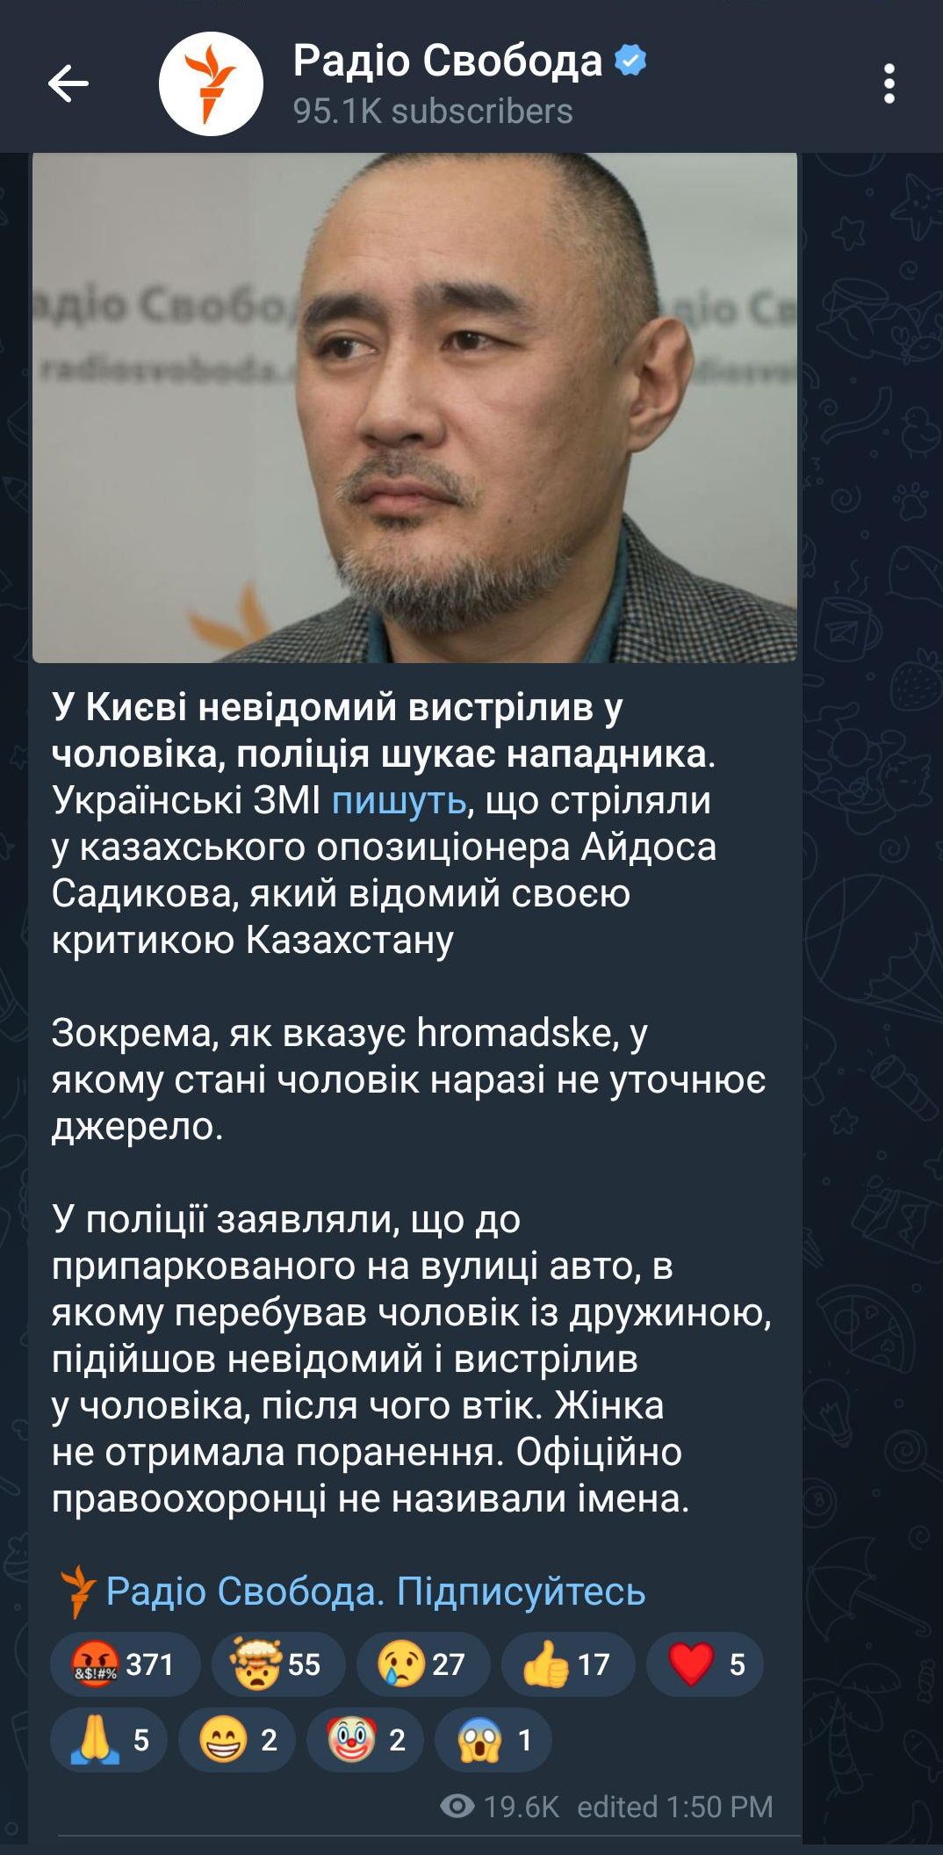

Engagement:
REACTIONS
Choice of emojis
Relevance

Slide 25


Engagement: comments
Comment section under some posts
Space for meaningful discussion and get audience feedback
Important: Moderation may be required to ensure discussions remain on topic and avoid misinformation by trolls and bots.

Slide 26

Engagement: contact
Submissions
by an audience
  Telegram chat
  Signal (safe submissions)
  Other platforms

Slide 27


CROSS PROMOTION:
LINKS TO THE CHANNELS UNDER EACH POST
When forwarding, the links got shared as well
Other RFE/RL newsrooms's Telegram channels
External media / Partners/ Officials/Bloggers

Slide 28


Cross promotion: recommendations
For crosspromotion
Relevant channels recommending your channel

Slide 29
Follow rfe/rl telegram channels
https://telegram.me/radiofarda | https://t.me/sibrealii
https://t.me/radiosvaboda | https://t.me/severrealii
https://t.me/ozodlikkanali | https://t.me/podcastRS
https://t.me/radiosvoboda | https://telegram.me/Azattyk_radiosu
https://telegram.me/currenttime | https://t.me/azatliqradiosi
https://t.me/azatutyuntv | https://t.me/azatlykradiosy
https://t.me/radioozodi | https://t.me/ekho_kavkaza
https://telegram.me/svoboda_radio | http://t.me/Azattykta
https://telegram.me/azattykrus | https://t.me/radioozodiTv
https://t.me/idelrealii | https://t.me/europalibera
https://t.me/krymrealii | https://t.me/europaliberamd
https://t.me/azattyq | https://t.me/RadioTavisupleba
https://t.me/radioazattyq | https://t.me/kavkazrealii
https://t.me/rferl | https://telegram.me/Azadi_Radio

Slide 30

Join the telegram channel in teams

Slide 31
THANK YOU!
Telegram Guideline

