Slide 1

Google Search Console Integration
Jan 29th, 2025

Slide 2
Agenda
Today we’ll cover:
Background
About the Product
Demo
Q&A

Slide 3
Background
Notes:
Section break

Slide 4


Background
Search is on the rise
Search is becoming an increasingly important referrer for our customers
The landscape continues to evolve with new search products (Discover, News, AI) and customers need more information to inform strategy
Wide range of tools: Customers use a number of Search tools ranging from free products (SEMRush, Google Search Console) to enterprise suites (NewzDash)
Notes:
Jessica: AQ isn’t powerful enough, Historical isn’t flexible enough
Top Feature Requests: Advanced. filtering, pivoting, additional metrics & metadata, customize and share dashboards, etc.
AQ is an old product that was built on assumptions that aren’t necessarily true anymore. creating custom dashboards is much more common now than it was back then, AQ was built for a world where our customers didn’t have as much data analysis experience as they do now
Brad - Customers would be really happy with the ability to visualize data in AQ (but still have the ability to get raw exports as well). basically giving them the ability to customize their own dashboards that continue to be updated over time would be extremely helpful for a lot of people.
Vanessa- I’ve heard AQ isn’t that friendly or intuitive for people who want to run reports but are not data savvvy/hard to use
AQ isn’t visually appealing like historical (that may be a long shot, but again something I’ve heard a few times)
The exporting isn’t great and I’ve heard that Marfeel has a way to get reports without exporting
MSV for AQ — being able to run the same report for MSV’s or multiple sites at once
Sun Times Media → Matt told us that they like the following about Parsely: 1. The ability to have customizable dashboards for users 2. Conversions insights are already ready to go in Parsely (not in early access) 3. Parsely's historical dashboard allows them to look back at publish dates more easily to understand how their evergreen stories performed over time.
Axel Springer Spain → main point of contact said that Marfeel has a tool similar to AQ where you can create the report within the dashboard and don’t have to export it to a CSV, etc,. in order to see the results. He mentioned the tools being similar — however, Marfeel did have the few extra things they needed that they felt were missing within Chartbeat. “In Chartbeat it was very difficult for us. When we were doing a query a little bit more complicated. You have to download the report, you have to take it to a CSV, you have to open it, you have to process it. While the Business Intelligence tool from Marfeel is super intuitive and all these segmentations that I’m talking about now can be extracted at the moment with your graph on the platform itself and the need to export data.”
Observer Media → He mentioned that he prefers Parse.ly’s real-time data as well as their intuitive reporting features and flexibility of metadata.
Exame → Exame said Marfeel is very similar with Chartbeat but has better tools such as: more user friendly historical dashboard, dynamic paywall, better filters, API plug, and Ad Manager plug.

Slide 5

Background
Why we made this
Disparate Tooling: Customers constantly swap between Chartbeat and other search tools to understand overall performance (inefficient, time)
Limited Access: Often times these Search tools are limited to a few users/seats and it can be challenging to share the insights with a wider base quickly and efficiently
Limited View: Search tools only provide part of the picture - top of funnel. Users need to understand how search impacts the full user journey and overall site and audience metrics
Notes:
Jessica: AQ isn’t powerful enough, Historical isn’t flexible enough
Top Feature Requests: Advanced. filtering, pivoting, additional metrics & metadata, customize and share dashboards, etc.
AQ is an old product that was built on assumptions that aren’t necessarily true anymore. creating custom dashboards is much more common now than it was back then, AQ was built for a world where our customers didn’t have as much data analysis experience as they do now
Brad - Customers would be really happy with the ability to visualize data in AQ (but still have the ability to get raw exports as well). basically giving them the ability to customize their own dashboards that continue to be updated over time would be extremely helpful for a lot of people.
Vanessa- I’ve heard AQ isn’t that friendly or intuitive for people who want to run reports but are not data savvvy/hard to use
AQ isn’t visually appealing like historical (that may be a long shot, but again something I’ve heard a few times)
The exporting isn’t great and I’ve heard that Marfeel has a way to get reports without exporting
MSV for AQ — being able to run the same report for MSV’s or multiple sites at once
Sun Times Media → Matt told us that they like the following about Parsely: 1. The ability to have customizable dashboards for users 2. Conversions insights are already ready to go in Parsely (not in early access) 3. Parsely's historical dashboard allows them to look back at publish dates more easily to understand how their evergreen stories performed over time.
Axel Springer Spain → main point of contact said that Marfeel has a tool similar to AQ where you can create the report within the dashboard and don’t have to export it to a CSV, etc,. in order to see the results. He mentioned the tools being similar — however, Marfeel did have the few extra things they needed that they felt were missing within Chartbeat. “In Chartbeat it was very difficult for us. When we were doing a query a little bit more complicated. You have to download the report, you have to take it to a CSV, you have to open it, you have to process it. While the Business Intelligence tool from Marfeel is super intuitive and all these segmentations that I’m talking about now can be extracted at the moment with your graph on the platform itself and the need to export data.”
Observer Media → He mentioned that he prefers Parse.ly’s real-time data as well as their intuitive reporting features and flexibility of metadata.
Exame → Exame said Marfeel is very similar with Chartbeat but has better tools such as: more user friendly historical dashboard, dynamic paywall, better filters, API plug, and Ad Manager plug.

Slide 6
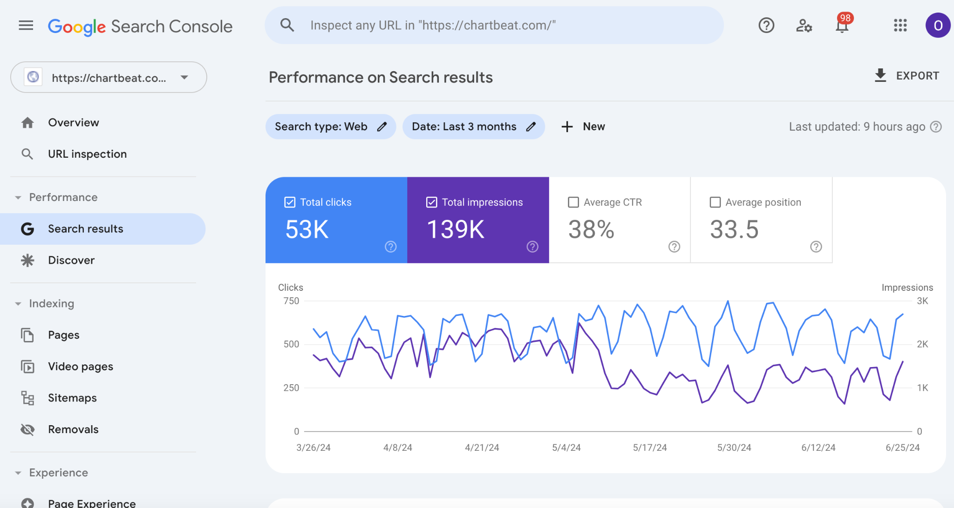
About Google Search Console
Google Search Console is is a free service offered by Google that helps you monitor, maintain, and troubleshoot your site's presence in Google Search results
GSC’s performance metrics provide insight into how your content is performing across key Google experiences:
Search
Discover
News
Performance metrics include:
Clicks
Impressions
CTR
SERP / position (search only)

Slide 7
Use Cases
See beyond your site metrics, by moving up the funnel
Understand how an article performed on search to inform / evaluate strategy
Identify top search/discover/news performers to uncover winning content strategies per channel (topics, headlines, etc.)
Uncover articles with strong search metrics that may be underperforming on site (and the reverse)
Identify keyword opportunities for ongoing coverage

Slide 8
About the Product
Notes:
Section break

Slide 9
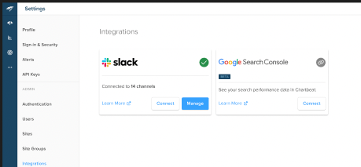
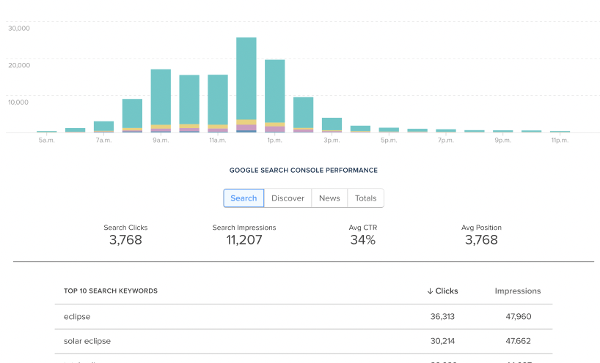
The Google Search Console Integration
Integration Module: New integration that Admins can activate in order to connect Chartbeat to their Google Search Console instance.
Historical Article Detail Page: Surface article level search metrics in the historical article detail page along with top keywords

Slide 10
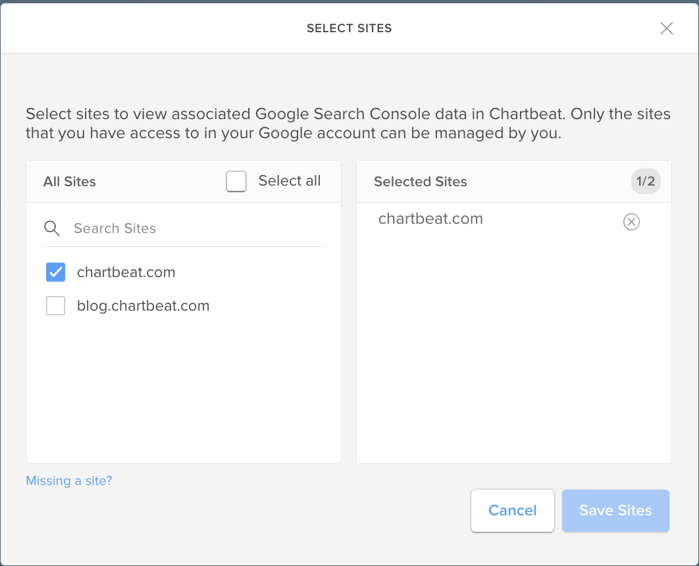
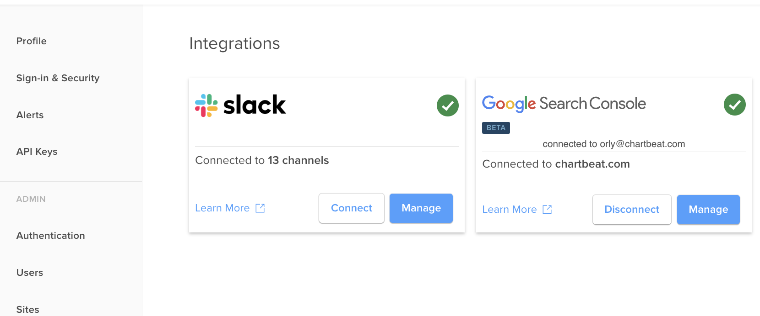
The Google Search Console Integration
Quick, user friendly O-auth flow. Users can connect to their GSC instance in seconds
Ability to select / remove at a site level
Disconnect from same UI

Slide 11
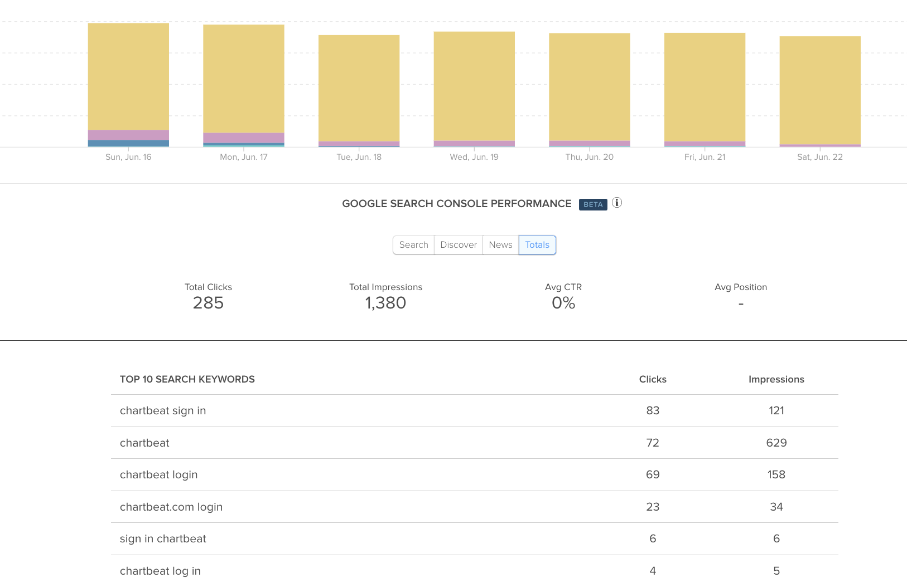
The Google Search Console Integration
Historical Article Detail Page
Top performance metrics (clicks, impressions, CTR)
Search engine result page rankings
Toggle across Search, Discover, News, Totals
Top 10 keywords (by clicks)
Notes:
example : https://chartbeat.com/publishing/historical/chartbeat.com/article/chartbeat.com%2Fsignin%2F%3Fnext%3D%2Fpublishing%2Fsites%2F?sort=total_engaged_time&startdate=2024-06-16&enddate=2024-06-22

Slide 12
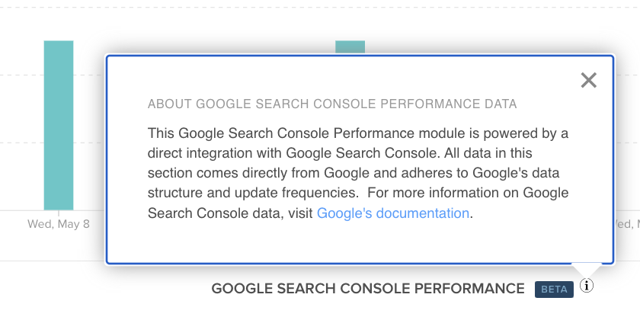
Important to Note
About the Data
Important to note that all data in this module comes directly from Google and comply with Google’s data schema and update cadences and will not match perfectly with Chartbeat data. Specifically:
GSC only provides data 48 hours after an article is published (PST)
We can only show data for articles with perfect URL match to CB

Slide 13
Demo
Notes:
example :
https://chartbeat.com/publishing/historical/chartbeat.com/article/chartbeat.com%2Fpublishing%2Fsites%2F?sort=total_engaged_time&startdate=2024-06-16&enddate=2024-06-22
: https://chartbeat.com/publishing/settings/integrations/?_force_user=cpalo@a360media.com
https://chartbeat.com/publishing/historical/chartbeat.com/article/chartbeat.com%2Fsignin%2F%3Fnext%3D%2Fpublishing%2Fsites%2F?sort=total_engaged_time&startdate=2024-06-16&enddate=2024-06-22

Slide 14
Q&A
Notes:
Section break

Slide 15
Thank you.

