Slide 1
USer Experience (UX) research
January 15, 2025

Slide 2
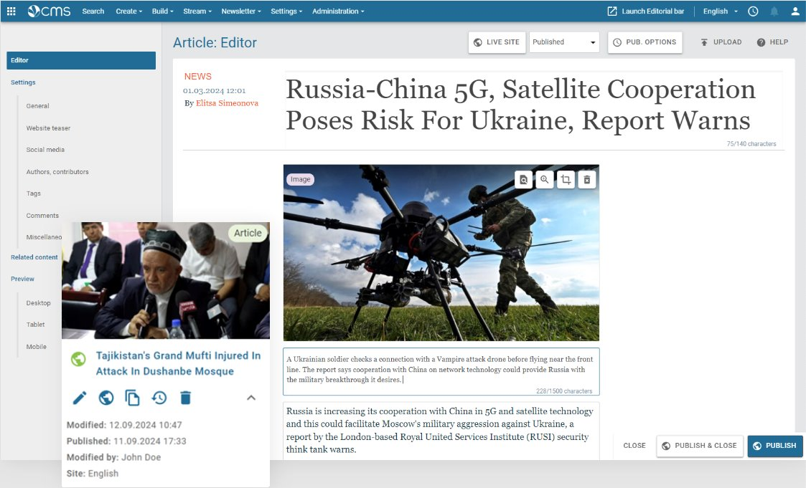
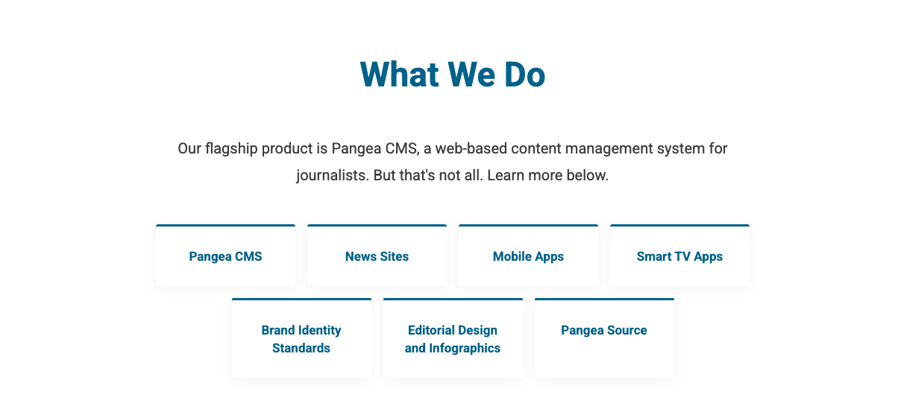
What We Do
Pangea CMS
News Sites
Mobile Apps
Smart TV Apps
Brand Identity standards
Editorial Design and Infographics
Pangea Source
Notes:
For those who haven't used Pangea frequently:
Pangea is our in-house design and development team.
Our flagship product is Pangea CMS, a web-based content management system designed for our journalists. But that's not all—we also provide additional products to support our journalists work.

Slide 3
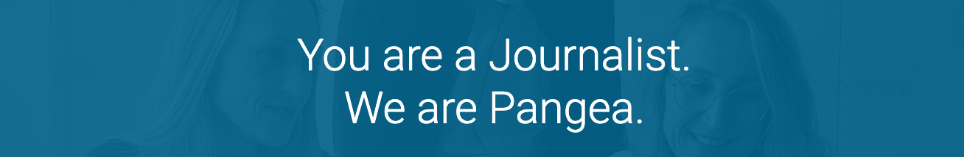
Notes:
Yesterday, when I opened the webpage of our Pangea team, I came across a statement that truly resonated with me: "You are journalists. We are Pangea." This phrase perfectly captures the essence of the story I’ll share with you today.
I will describe how we at Pangea collaborate with you, the journalists, and how this cooperation helps us develop features that support your work.
Part of this collaboration is carried out through UX Research.

Slide 4
Topics
What is UX Research?
Benefits of UX Research
Methods
Experience from a real project
Upcoming projects you can be a part of :-)
Notes:
I’m going to talk about:
What UX Research is
Its benefits
Methods commonly used in research projects
The UX research steps we followed during the development of one of the most recent features we released
At the end of the presentation, I will also share a list of upcoming projects where we plan to use UX Research.

Slide 5
What is UX Research about?

Slide 6
UX Research aims to understand user behaviors, needs, and motivations to create products or services that provide meaningful and intuitive experiences to users.
Notes:
This was said by Donald Norman, the usability engineer, who focused on designing products that offered not just functionality but also joyful and intuitive experience.
Resource:
Donald Norman - often credited with popularizing the term User Experience (UX). (cognitive scientist and usability engineer, in early 1990s)
https://www.nngroup.com/people/don-norman
https://medium.com/@mbksuperstar32/-ce2b3bceaa0d

Slide 7
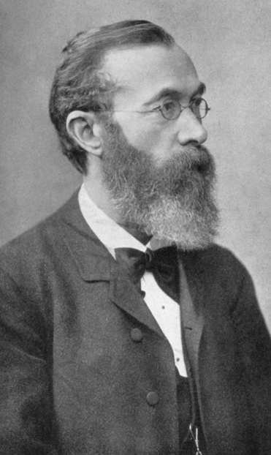
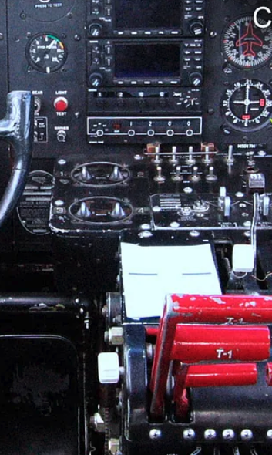
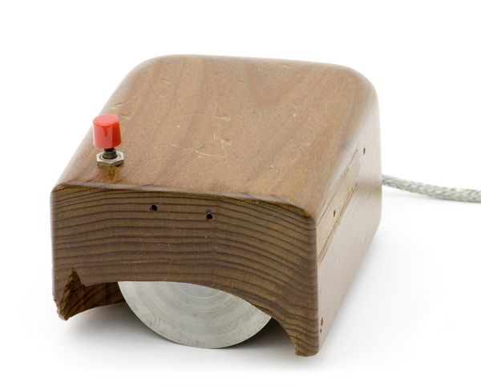

First mouse
(1968)
Human cognition and behavior (1875)
Aircraft cockpits
(1940-1950)
Today
Notes:
This approach isn’t new. It started in psychology in the 19th century, and there have been various milestones throughout history when UX research gained greater importance.
For example—can you imagine that UX research can save lives? When you understand user behaviors, needs, and motivations, it can have life-saving impacts. During World War II, UX research was used to design airplane cockpits in a way that minimized human errors and improved pilot safety.
As computers became more common, people realized they were often hard to use. Researchers and designers began focusing on user interfaces and usability.
You can see this pretty mouse :-)
With the growth of the internet, UX research became even more important.
Today, UX research is a well-established and keeps growing with new technologies. Its main principle is still to understand human behaviour.
Resources:
Wilhelm Wundt and William James: https://webspace.ship.edu/cgboer/wundtjames.html
Image of Wilhelm Wundt: https://en.wikipedia.org/wiki/Wilhelm_Wundt
A 100-Year View of User Experience: https://www.nngroup.com/articles/100-years-ux
The complete history of UX (User experience): https://www.uxdesigninstitute.com/blog/history-of-ux/?utm_source=chatgpt.com
Industrial revolution: https://scottjancy.com/the-industrial-revolution-revisited-the-transformation-of-work/ (studies of human factors in relation to tools and machines)
Voice assistant: https://dadofad.com/blog/inspiring-ui-ux-designs
Pilot Error, Chapanis and The Shape of Things to Come: https://uxmag.com/articles/pilot-error-chapanis-and-the-shape-of-things-to-come
First mouse: https://www.computerhistory.org/revolution/input-output/14/350 (Doug Engelbart)

Slide 8
Which Methods we use

Slide 9
Interviews
  It's a casual chat.
  Space for discussion and your questions.
  We learn from your experience, which helps us design features that fit your work.
Why?
How?
How does this help you...?
What do you miss there...?
Could you describe the process of...?
How do you use... ?
Notes:
There are various qualitative and quantitative methods we can use in UX research. Here, I’m sharing the two methods we use most often.
(semi structured)Interviews
It's a casual chat. We need understand your work.
We need to understand How? you work in your daily live and Why? you work the way you do.
For example, we ask you
Could you describe us your current workflow?
Could you describe us your experience with a particular feature in Pangea?
During the interviews, we learn from your experiences to understand your needs. This helps us gain a better understanding of your processes and, as a result, design features that align with your work.

Slide 10
Usability testing
    We kindly ask you to explore the prototype.
    Space for discussion and your questions
    We learn from your feedback, whether we are on the right track or if we need to provide a different solution.
How?
Why?
What do you miss there...?
How does this fit into your workflow?
What do you expect..?
Notes:
Usability or concept testing
This typically happens when we have the first concepts of new features.
We show you the prototype and ask you to go through the prototype and give us the feedback.
Thanks to that we can see if we are on the right track or if we need to provide a different solution.
This is also an opportunity for you to try the upcoming feature and influence its design.

Slide 11
Meeting Overview: Simple and Clear
No preparation needed, we've already prepared the questions.
Share your experience from your daily work.
We're not testing your skills, just looking for your honest feedback.
All information is anonymized and used only for our team.
Notes:
I’d like to mention a few points you can expect for all meetings that we invite you:
There’s no preparation needed before our chat. We’ve already prepared the topics. All we need is your time, which will be between 15 minutes to 1 hour at most.
During the meeting, you’ll share your experience from your daily work or provide your feedback.
It’s important to note that we’re not testing your skills; we just really appreciate your honest feedback. We don’t take it personally, you can be open.
Lastly, I want to mention that the findings from the sessions are anonymized. We won’t share your name with anyone out of our team.

Slide 12
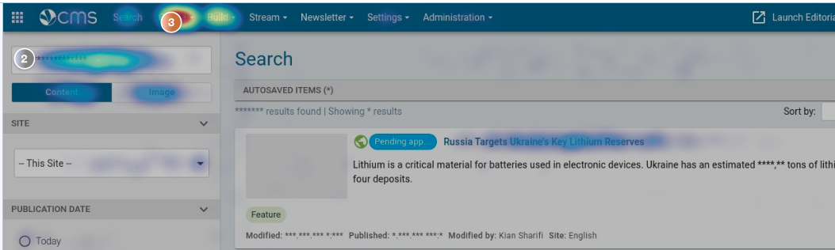
Analytics
How many?
Approve
and publish_button
21k
Approve
and publish_dialogue
20k
Request approval
and save_button
536
Text comparison_toggle
236
Notes:
We also use quantitative techniques. Such us analytics when we can see eg. which feature is used most often.
Again, we do not track any personal data.
Also, we are going to send the surveys with questions.
___
The beauty of research lies in its flexibility. Depending on what information we need and how much time we have, we choose the most appropriate method.
Qualitative Methods
The most common qualitative methods we use are:
Interviews
Usability testing
We also plan to send surveys with open-ended questions.
In qualitative research, we aim to understand why users behave in certain ways.
For example, we try to understand how you use specific features and why you prefer to work in a particular way.
Quantitative Methods
In quantitative research, we use:
Statistics from our Pangea database
Monitoring data from Google Analytics and Hotjar
Surveys
With quantitative methods, we focus on numbers and specific data, such as how often specific features are used or in which countries, which buttons are used the most..
It’s important to note that in third-party tools, we do not track who is using our application or which content is created. All data is anonymized and secured.
Resources:
https://screeb.app/blog/user-research-benefits

Slide 13
Surveys
Why?
How many?
How?
Notes:
Additionally, we are discussing the option of sending out surveys with questions.
These will provide us with quantitative information, and there will also be space for you to share your feedback.
___
Resources:
https://screeb.app/blog/user-research-benefits

Slide 14
content approval workflow
Cooperation with users on new feature
Notes:
Let’s take a look how UX research helped us when we developed Content Approval feature.

Slide 15

content approval – Influence of our users
Interviews with stakeholders
Workflow approved by stakeholders
Interviews
Collecting feedback
"There is nothing to change"
Usability testing
“We need to see what changed”
Usability testing
“This is how we work!”
Feedback shared
with stakeholders
Users
(Pilot users)
️
🎉
🤔
Pangea
First concept
New workflow designed
First visual designs
Second visual designs
Release
(for pilot users)
Summarized
feedback
Notes:
Describe the image: At the bottom, you see Pangea activities, while at the top, above the timeline, you can see continuous communication with our pilot users.
In a nutshell: Requirement: to develop a feature in Pangea that would allow our users to review changes in published content.
Thanks to research activities it will be continuous communication with you.
Now I'm going to share with you the Research steps that we did:
Describe the steps: After receiving the requirements, we created the first concept for the new workflow. We shared it with our stakeholders for feedback, and the new workflow was approved.
This gave us the green light to move forward with visual designs. Once the designs and prototype were ready, we tested them with users.
During usability testing we realised that our users were confused and didn’t understand certain parts of the feature. This design was not approved,
Our designers after discussion with developers fixed the issues and created a new version of the design, which we tested again with users. This time, the went through the prototype without any problem and the feedback was very positive! This feedback ensured us that we are on the right path.
After that, we started the final development and released the feature.
Our pilot users then used this feature in their teams for two weeks. After two weeks, we returned to them to gather their feedback. We wanted to be sure that this feature would be feasible for the rest of the company.
Most of the feedback was positive, though we also received some suggestions for improvements.
All the feedback, was shared by Misa during the stakeholder meeting to keep everyone informed.
After that the feature was turned on for the rest of the company.
Then (which is not part of this diagram), our customer care team prepared training sessions for all our users. They incorporated answers to the questions and concerns we received from users during the interviews. We wanted to be sure that the training would also answer all the users' questions.
In this process, you can see:
Constant communication with our users.
We strive to be transparent about what is happening.
You can also see the important role of pilot users, as they can influence the design of the feature for the whole company.
Thanks to interviews and usability testing, we were able to identify issues early on and fix the design quickly before it was developed.

Slide 16
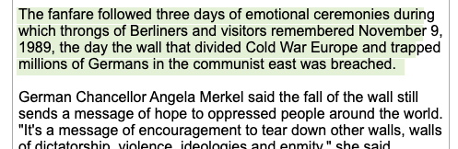
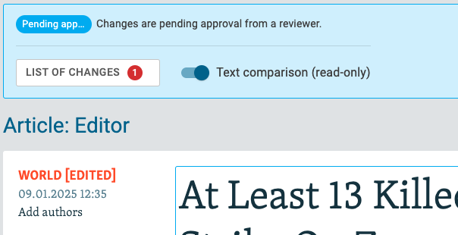

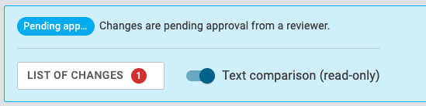

Content approval- Usability testing
Before
Prototype
After
Updated prototype
"Edit" button was removed - users needed to edit content immediately.
Edit mode was kept as the default to maintain the current behavior. New "Text comparison" was added to display the changes.
"I need to fix the changed content right away... this would add an extra click."
Notes:
I would like to show you example of the changes in prototype made based on the feedback. This design was radically changed.
Initially, we wanted to provide our users with an overview of what was changed in the content and then allow them to make additional enhancements by clicking the Edit button.
However, our users told us that it’s important for them to be able to edit the text right away without any extra clicks.
As a result, our designers discussed the technical possibilities with our developers and designed the solution that is used now – instead of the Edit button, there is a toggle button.
By default, the content can be edited, as our users asked and expected.

Slide 17
Why is it beneficial to conduct research in our projects?
UX Research benefits

Slide 18
Benefits of participating in UX Research
Your feedback influences the design of the feature
Enhanced user experience (usability)
Continuous communication
You will be the first to see Pangea's feature proposal
Process optimization
We see you as partners in the delivery process
Notes:
As UX Research is based on understanding user needs, it brings various benefits..
Your feedback influences the design of the feature
We organize with you several meetings to receive your feedback on initial concepts as well as detailed designs.
Enhanced User Experience (Usability)
We prepare and share an interactive prototype so that you can try its interactivity and usability. Based on your feedback we adjust the design.
Continuous Communication
We will keep you updated throughout the delivery process, from concept to release.
If you are interested, we can share with you summarized feedback collected from users.
You will be the first to see Pangea's feature proposal
We will share with you feature proposal and discuss its feasibility and questions.
So, you will be the first to see and influence new feature used across the company.
This might help you to prepare your team for smooth onboarding and adjust your processes proactively.
Process Optimization
Some of our teams use discussions about new features as an opportunity to take a deep dive into their current processes and refine the way their teams work together.
We see you as partners in the delivery process
Your opinions matter. Adjustments are made based on mutual feedback, time and technical feasibility.
Resources:
https://www.uxdesigninstitute.com/blog/user-research-in-ux-design/
https://screeb.app/blog/user-research-benefits

Slide 19
Upcoming projects

Slide 20
Upcoming projects
Project | Research topics | Meeting
AI content assistance | How does Pangea AI fit into current processes for creating content headlines? | Interviews Usability testing
Newsletter page redesign | How does new newsletter layout fit our users? | Interviews Usability testing
Pangea Adoption by new users | We would like to know if the current onboarding process is sufficient for our users. | Interviews
Multimedia (audio/video) category redesign |  | Interviews Usability testing

Slide 21
How to join the interview
You’ll receive an email invitation with the topic details.
Book a time or suggest one that works best for you.
We’ll meet either online or offline. 😊
Note: Before we reach out, all contacts are discussed with digital production manager (monthly meetings – we inform them about the upcoming research projects).
Notes:
You’ll receive an email invitation with the topic details.
If you’re not the right person or are busy, feel free to forward the invite to someone more suitable.
Book a time or suggest one that works best for you.
The slot is automatically booked in your calendar.
We’ll meet either online or offline. 😊
Note: Before we reach out to you, all contacts are discussed with digital production manager (monthly meetings – we inform them about the upcoming research projects).

Slide 22
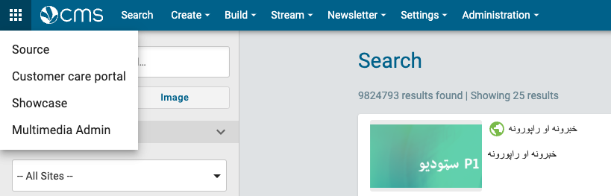
You can also contact us
Create a ticket on customer care portal
Notes:
We aim to build Pangea on partnership, open discussions, and feedback. Thank you to everyone who has contributed so far—we welcome more comments, questions, and ideas.
You can reach us anytime via email or Teams. The most suitable way is to contact us via customer care tickets so that we can eg. Summarize the topics that we can receive from multiple users.
Pangea is here for you.

Slide 23
Let's improve pangea together
Pangea is here for you.
Notes:
In this presentation, I shared how we work with users during feature development process and how your feedback shapes Pangea's design and user experience.
Thank you to everyone who has contributed so far—we welcome more comments, questions, and ideas.
You can reach us anytime via email, Teams, or customer care tickets.
Pangea is here for you.
We aim to build Pangea on partnership, open discussions, and feedback.

Slide 24
THANKS!
Any questions?

Slide 25

THANKS!
Any questions?
PokornaM@rferl.org

